Slide 1
Bloodborne Pathogens
CURRENT AS OF: January 2025
Oklahoma State University
VAL FREEMAN
OKLAHOMA STATE UNIVERSITY
ENVIRONMENTAL HEALTH AND SAFETY
(405) 744-7241

Slide 2
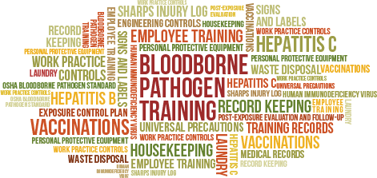
Objectives
What is a Bloodborne Pathogen (BBP)?
Who is at risk?
Modes of transmission.
What are your employer’s responsibilities?
What is an exposure control plan?
How do I prevent or reduce exposure or the spread of BBPs.
Types of PPE, proper use, and disposal.
Emergency actions following possible exposure.

Slide 3

Who is at risk? Could you be exposed at work?
First responders
Law enforcement
Laboratory personnel
Housekeeping personnel
Facilities personnel
Nurses and doctors
Other healthcare personnel

Slide 4
OSHA 29CFR 1910.1030
In March 1992, OSHA's Bloodborne Pathogen Standard, 29 CFR 1910.1030 took effect. It was last updated in 2001.
This standard was designed to prevent more than 200 deaths and 9,000 Bloodborne infections every year.
Requires employers to identify employees who may be at risk of occupational exposure to BBP as part of their job and develop methods and controls to eliminate or reduce workplace exposure to BBP.

Slide 5

What is a BBP, and why are they important?
Microorganisms that are carried in blood that can cause disease in humans.
These pathogens include, but are not limited to:
  Hepatitis B
  Hepatitis C
  HIV
OSHA estimates 5.6 million workers in health care and other facilities are at risk of exposure to bloodborne pathogens.
Bloodborne pathogens can be transmitted through blood or ‘other potentially infectious material’ (OPIM).

Slide 6
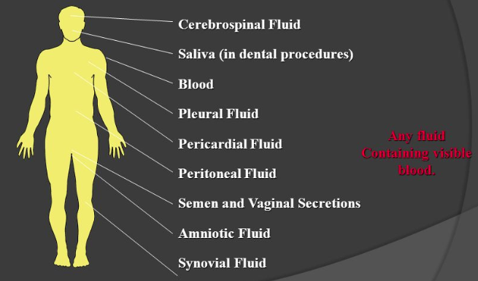
What are “Other Potentially Infectious Materials?
Any fluid containing visible blood.

Slide 7
Universal Precautions
Treat all blood, body fluids, secretions, excretions (except sweat), non-intact skin, and mucous membranes as if they contain transmissible infectious agents.
Also make sure to:
  Use good hand hygiene
  Use gloves, gowns, masks, eye protection, and/or face shields depending on the anticipated exposure
  Use safe injection practices

Slide 8

Could you contract a bloodborne pathogen doing these things?
Administering first-aid?
Cleaning the restroom?
Using a tool covered with dried blood?
Cleaning up after an accident?
Cutting yourself with something that is
contaminated with blood?

Slide 9

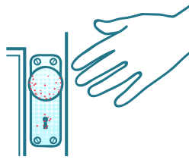
Modes of Transmission
Direct
Indirect
Physical contact between an infected person and a susceptible person.
Touching an infected individual
Sexual contact
Contact with oral secretions
Contact with body lesions.
Person is infected from contact with a contaminated surface.
Some organisms are capable of surviving on surfaces for an extended period of time.
To reduce chance of transmission by indirect contact, regularly clean surfaces that are touched a lot.

Slide 10
Modes of Transmission
It is important to be aware of the ways exposure and transmission are most likely to occur for your work situation.
  A puncture or cut from contaminated sharps is the most common way employees are infected by BBP in the workplace.
Unbroken skin provides a resistant barrier to bloodborne pathogens. However, infected blood can enter your system through:
  Open sores or cuts
  Abrasions
  Acne
  Damaged or broken skin (e.g. sunburn or blisters)

Slide 11
Modes of Transmission
You CAN be exposed from | You CANNOT be exposed from
Blood-to-blood contact | Mosquitoes
Blood and OPIM contact with non-intact skin (cuts, abrasions) | Air or water
Contaminated sharps penetrating skin | Tears
Blood and OPIM contact with eyes | Sweat or urine
Blood and OPIM contact with mucous membranes of the mouth and nose | Saliva, as long as there is no blood present

Slide 12
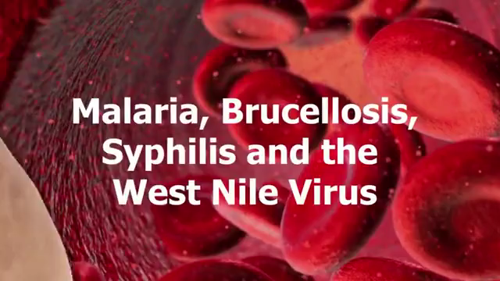
Review Video

Slide 13
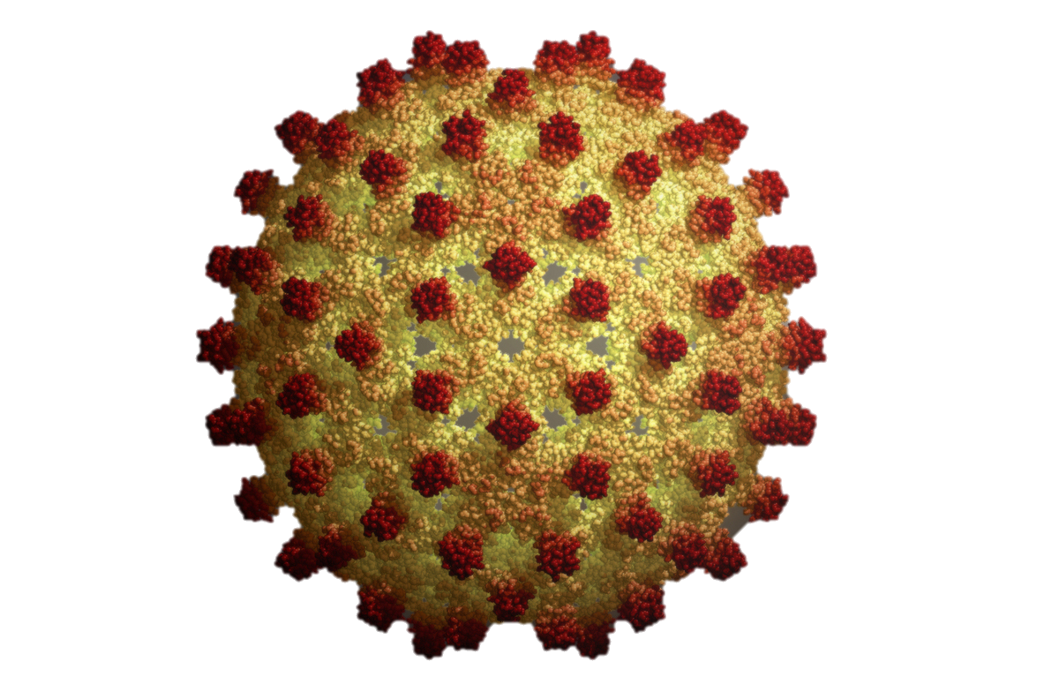
Hepatitis B (HBV)
An infection of the liver that can cause scarring, liver failure, and liver cancer; and is potentially life-threatening.
Usually an acute infection, but 5% to 10% of adults and children older than 5 who have HBV end up with a chronic infection. There is a vaccination available!
  If you are exposed to HBV the vaccine is effective at preventing the disease if administered within 24 hours of exposure.
As many as 850,000 to 2.2 million people in the U.S. are estimated to be living with HBV.

Slide 14
Hepatitis B (HBV)
Infection rates have dropped from 200,000 in the ‘80s to 20,000 in 2016.
HBV can survive for at least one week in dried blood.
Symptoms, such as jaundice, fever, fatigue, abdominal pain, nausea, and vomiting and can occur 60 to 150 days post-exposure (avg. of 90 days).
  Some people exposed to HBV do not develop symptoms
  67% of people living with HBV do not know they have the virus but are lifelong carries who still transmit the disease.

Slide 15
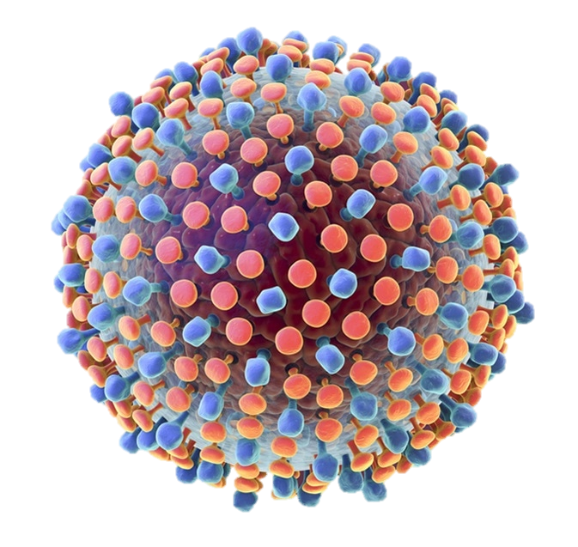
Hepatitis C (HCV)
HCV is a contagious liver disease that affects about 2.5 to 4.7 million people in the U.S.
Can range from mild illness lasting a few weeks to a serious, lifelong illness. About 75% to 85% of people infected with HCV develop a chronic infection.
HCV can live up to 3 weeks outside the body, but only at room temperature on clinical or household surfaces like a drawer handle or sink.

Slide 16
Hepatitis C (HCV)
Symptoms include: fever, fatigue, abdominal pain, nausea, loss of appetite, weight loss, and jaundice.
The average time from exposure to symptoms showing is 2 to 12 weeks. However, most people do not develop symptoms.
  75%-85% of people living with HCV do not know they have the virus.
No vaccination available; however HCV protease inhibitors used in combination with other antiviral drugs have over 90% cure rates with a 12-week treatment course.

Slide 17
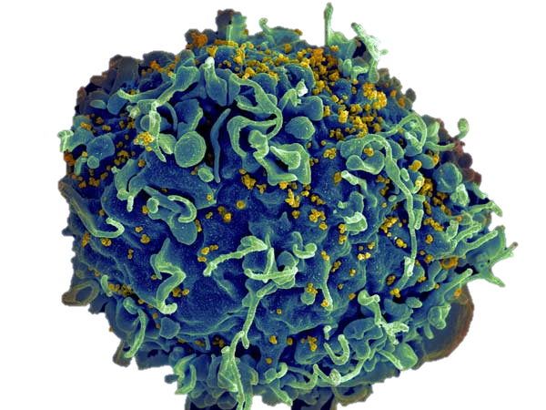
Human Immunodeficiency Virus (HIV)
HIV is the virus that leads to acquired immunodeficiency syndrome (AIDS).
  About half of the people infected with HIV develop AIDS within ten years.
Almost 37,981 people diagnosed in the U.S. in 2022 and 1.2M total living with HIV.
Depletes the immune system by destroying blood cells that help the body fight diseases.

Slide 18
Human Immunodeficiency Virus (HIV)
HIV is very fragile and survives less than 24 hours outside the human body. The risk of occupational exposure to HIV is very low.
  Even though the risk is low, every precaution must be taken to avoid exposure.
Symptoms include fever, diarrhea, headaches, feeling tired, nausea, and weight loss. They may develop 2 to 4 weeks post-exposure and may last for a few days to several weeks.
  Approximately 1 in 7 people do not develop symptoms but are still capable of infecting others.
There is no cure for HIV and it can be fatal, but with proper medical care it can be controlled.

Slide 19
What is the risk of infection following an occupational exposure?
HBV
  Personnel who have received hepatitis B vaccine and developed immunity to the virus are at virtually no risk for infection.
  For a susceptible person, the risk from an exposure ranges from 6 – 30%.
HCV
  The average risk for infection after exposure is approximately 1.8%.
HIV
  The average risk of HIV after exposure is 0.3%.

Slide 20
Does 29 CFR 1910.1030 only apply to HBV, HCV, and HIV?
No! Here are some other infectious agents that fall under the standard:
Plasmodium species | Spirillum minus
Treponema species | Colorado Tick Fever Viruses
Babesia species | Borrelia species
Brucella species | Creutzfeldt-Jakob agent
Leptospira species | Human T-lymphotropic Virus Type I
Francisella species | Hemorrhagic Fever Viruses
Streptobacillus moniliformis | Mycobacterium tuberculosis
Rabies Virus | Anthrax
Vaccinia | Epstein-Barr Virus
Human Papillomavirus | Simian Vacuolating Virus 40

Slide 21
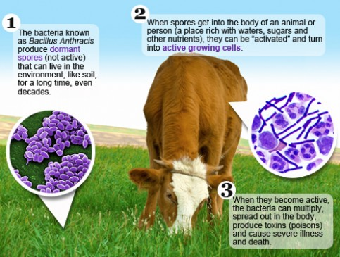
Cutaneous Anthrax
Happens when anthrax spores get into the skin.
Most often from handling infected animals or contaminated animal products like hides and hair.
Infection develops from 1 to 7 days after exposure.
Without treatment, up to 20% of people with cutaneous anthrax may die.

Slide 22

Rabies
All species of mammals are susceptible.
Transmitted through:
  Bites
  Infected blood or saliva gets into an open cut/wound
  Contamination of mucous membranes
  Aerosolization
Incubation period of weeks to months and is fatal once symptoms occur.
Symptoms include:
  Weakness
  Fever
  Headache

Slide 23
Why does 29 CFR 1910.1030 apply to finite and continuous human cell lines?
The CDC’s Biosafety in Microbiological and Biomedical Laboratories recommends that all work with non-human primate and human cells follows the Bloodborne Pathogen Standard.
There is extensive testing required to ensure that cell lines are free of all bloodborne pathogens – Not just Viral Hepatitis and HIV (EBV, HTLV, HPV, CMV . . . ).
Establishment of an Exposure Control Plan is much easier than maintaining documentation of testing for OSHA.
Safety is our number one priority.

Slide 24

Employer Responsibilities
OSHA’s Bloodborne Pathogen Standard states that anyone whose job requires exposure to BBP is required to complete BBP training.
  Training is conducted face to face, not online
  Training is required annually
Anyone whose job requires exposure to BBP is offered vaccines and post exposure evaluation following any possible exposure incidents at no cost to the employee.
Employer must offer personal protective equipment (PPE) and a written exposure control plan.

Slide 25
Exposure Control Plan
Plan must be reviewed/updated at least annually, when a process changes, and when a new process is implemented.
Must be available within your department.
  EHS can provide current template.
Address the implementation of Universal Precautions and the identification and use of engineering controls.
Provisions for PPE and training.
Hep B vaccinations available for all employees with occupational exposure.
Post exposure evaluation and follow-up for any occupational exposure.
Use of signs and labels to communicate hazards.
Record keeping.

Slide 26

Bloodborne Pathogen Binder
Suggested binder set up:
  OSHA Bloodborne Pathogen standard 1910.1030
  Exposure Control Plan with all appendixes
  List of all employees under plan
  Copies of completed/signed Hep B vaccination forms
  Training documentation
  Self inspection documentation
  Completed parameter sheet
EHS can assist with program set up and may do periodic checks.

Slide 27
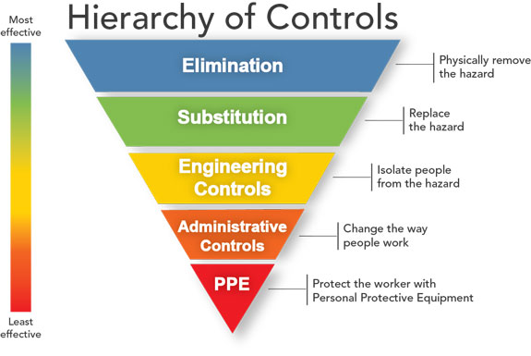
Exposure Prevention
Elimination: Physically remove the hazard.
Substitution: Replace the hazard
Engineering Controls: Isolate workers from the hazard.
Administrative Controls: Change the way people work.
PPE: Protect the worker with personal protective equipment.

Slide 28
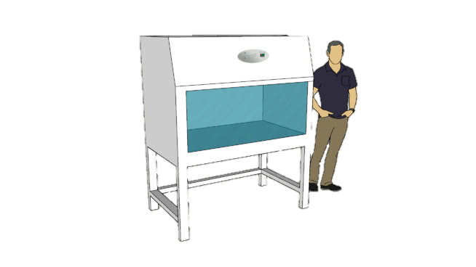
Engineering Controls
Reduce exposure by either removing or isolating the hazard or isolating the worker from exposure by using devices and advances in technology.
Must be examined, maintained, and replaced on a regular schedule to ensure their effectiveness.
Examples: Sharps containers, biohazard waste containers, safer medical devices, needleless systems.

Slide 29
Administrative/Workplace Controls
Restrict eating, drinking, smoking, applying cosmetics, and handling contact lenses near blood or OPIMs.
Prevent the storage of food or drink in locations where blood or OPIMs are kept.
Provide and require the use of handwashing facilities.
  Require the use gloves when working with or cleaning up blood or OPIM spills.
  Prohibit recapping, bending, removing, shearing, or breaking contaminated needles.
  Prohibit picking up sharps or broken glass with bare hands.

Slide 30




Personal Protective Equipment
PPE must be used if engineering controls and work practice control do not eliminate exposure.
Employer is required to provide appropriate PPE free of charge and must clean, repair, or replace it as necessary.
PPE is considered appropriate only if it prevents the passage of blood or OPIM to the employees’ work clothes, street clothes, undergarments, skin, eyes, mouth, or other mucous membranes under normal conditions of use.
PPE can consist of gloves, masks, safety glasses, and respiratory protection.
PPE selection is based on the task and degree of exposure anticipated.

Slide 31
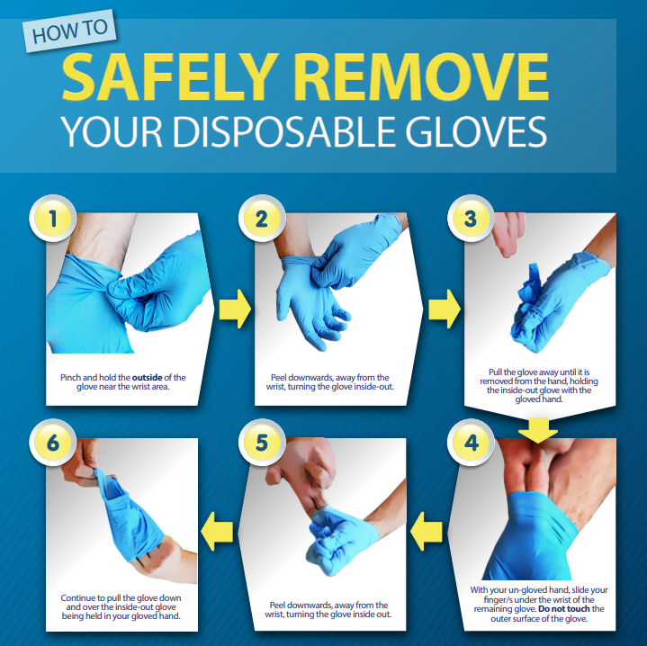
Proper Use and Handling of PPE
Wear appropriate gloves when there is a reasonable hazard of contact with infectious materials.
Replace gloves as soon as possible if they become torn, punctured, contaminated, or compromised; and when moving between patients.
Disposable (single-use) gloves cannot be washed or decontaminated for reuse.
Remove contaminated PPE with care.
Always wash your hands after removing contaminated gloves.
Wear face and eye protection if risk of splashes, sprays, splatters, or droplets of blood or OPIM are present.

Slide 32
Proper Use and Handling of PPE
Hands on demonstration

Slide 33

Biohazard Labels
Warning labels will be affixed to items such as:
  Containers of regulated waste
  Containers of contaminated reusable sharps
  Refrigerators and freezers containing blood or OPIMs
  Containers used to store, transport, or ship blood or OPIMs
  Contaminated equipment being shipped or serviced (must state which portion of the equipment is contaminated)
  Bags or containers of contaminated
  laundry

Slide 34
Biohazard Labels
Labels must be fluorescent orange or orange-red, contain the biohazard symbol and the word “biohazard”.
Labels should be attached to the object by string, wire, adhesive, or another method to prevent loss or unintentional removal.
Biohazard warning labels are not required by OSHA when red bags or red containers are used, but it is a good work practice to label them anyway to avoid any chance of confusion.

Slide 35
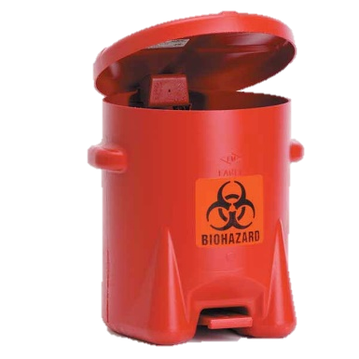
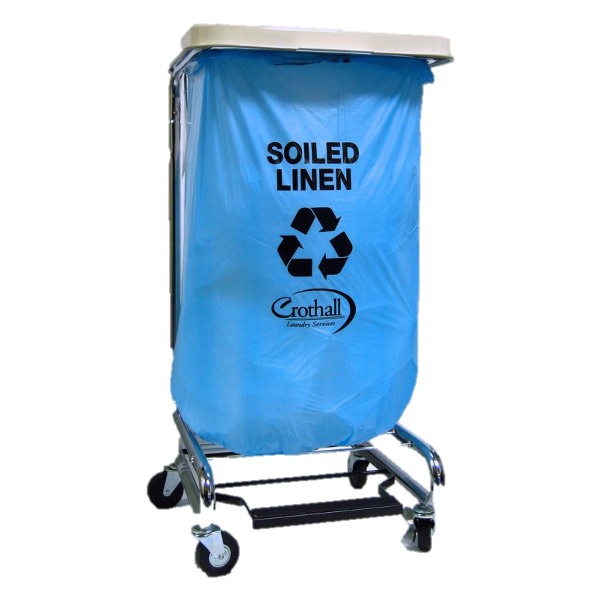
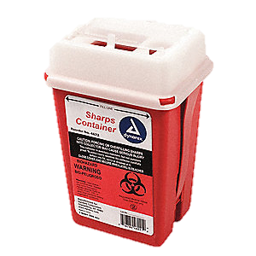
PPE, Contaminates, Sharps, and Waste Disposal
PPE must be removed before leaving the area of exposure or when it becomes contaminated.
The containers must be red or clearly labeled as containing biohazardous waste.
Gloves and other PPE should be disposed of in an appropriate area
Sharps should be disposed of in sharps a containers that is leak-proof, puncture-resistant, and labeled/color-coded red
Blood and OPIMs should be disposed of in a closable, leak-proof, and labeled/color-coded container
Work clothes and equipment that have been in contact with blood or OPIM must always be isolated and decontaminated.

Slide 36
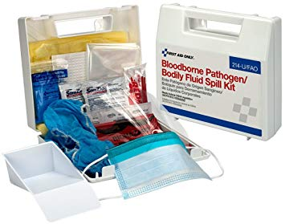
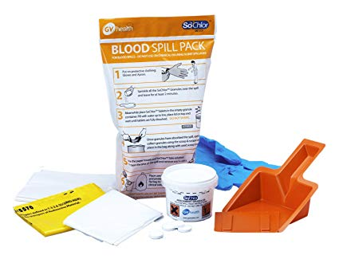
Decontamination
  When cleaning up blood or OPIM:
    Proper PPE must be worn at all times
    Cover a spill with paper towels or rags to prevent splashing
    Pour a solution of 5.25% bleach diluted between 1:10 and 1:100 with water over the towels and let it stand for at least 10 minutes (or as recommended by the manufacturer)
    An EPA approved virucidal disinfectant may also be used to disinfect and clean up biohazardous material
    Make sure all material and PPE used to clean and contain a spill are also disinfected or properly disposed of and labeled as biohazardous waste
    Blood / BBP spill kits are available commercially

Slide 37
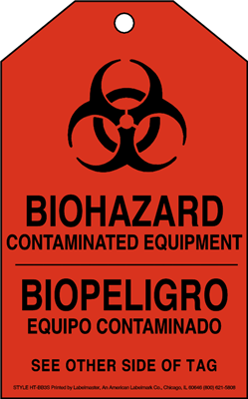
Decontamination
  Decontaminate exposed equipment as soon as possible after use.
    If this is not possible, a readily observable label identifying the contaminated equipment shall be attached to state which portions remain contaminated
  Routinely check equipment and reusable containers/receptacles and decontaminate them prior to using, servicing, or shipping.

Slide 38
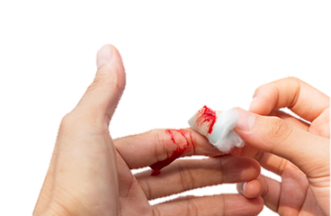
What happens after an accidental exposure - Employee
Wash exposed area with soap and water and complete first aid as necessary
Report to your supervisor immediately, or as soon as possible after the incident occurs
Fill out the first section of the Employee Injury Report (EIR) form at the time of the injury
  Supervisor should fill out the second part of the form at the time of the injury
NOTE: These instructions are located in section 6 of the ECP template from EHS. Additional instructions are also located at the top of the EIR form. Forms are located on the EHS website.

Slide 39
What happens after an accidental exposure - Employee
Supervisor should accompany you to the designated medical facility
  During normal business hours: report to University Health Services
  Outside normal business hours: report to AMC Urgent Care
You will receive a confidential medical evaluation
  With follow up as needed
With consent, your blood will be taken and tested
  Results will be shared with you, with appropriate counseling
  Any treatment prescribed will be made available to you
  If there is a source individual, they will be identified (if possible)
    They will also be tested and results will be made known to you

Slide 40

What happens after an accidental exposure - Supervisor
Assess the situation and determine if the incident is an occupational exposure to a biohazardous substance
If it is an exposure, locate and fill out the Employee Injury Report form and take the employee to the designated medical facility.
  If possible, take the completed EIR with you when you to go UHS. If that is not possible, send the employee and fax the form to UHS as soon as possible
Fill out the Hazardous Substance Employee Exposure Report form and, if applicable, fill out your sharps injury log
  Sample sharps injury log is located in Appendix D of the ECP template from EHS
Send a copy of the EIR to Human Resources and EHS (OHSP)

Slide 41
What happens after an accidental exposure - Students
Wash exposed area with soap and water and complete first aid as necessary
Report to your supervisor immediately, or as soon as possible after the incident occurs
Talk to Risk Management for compensation forms if needed.

Slide 42
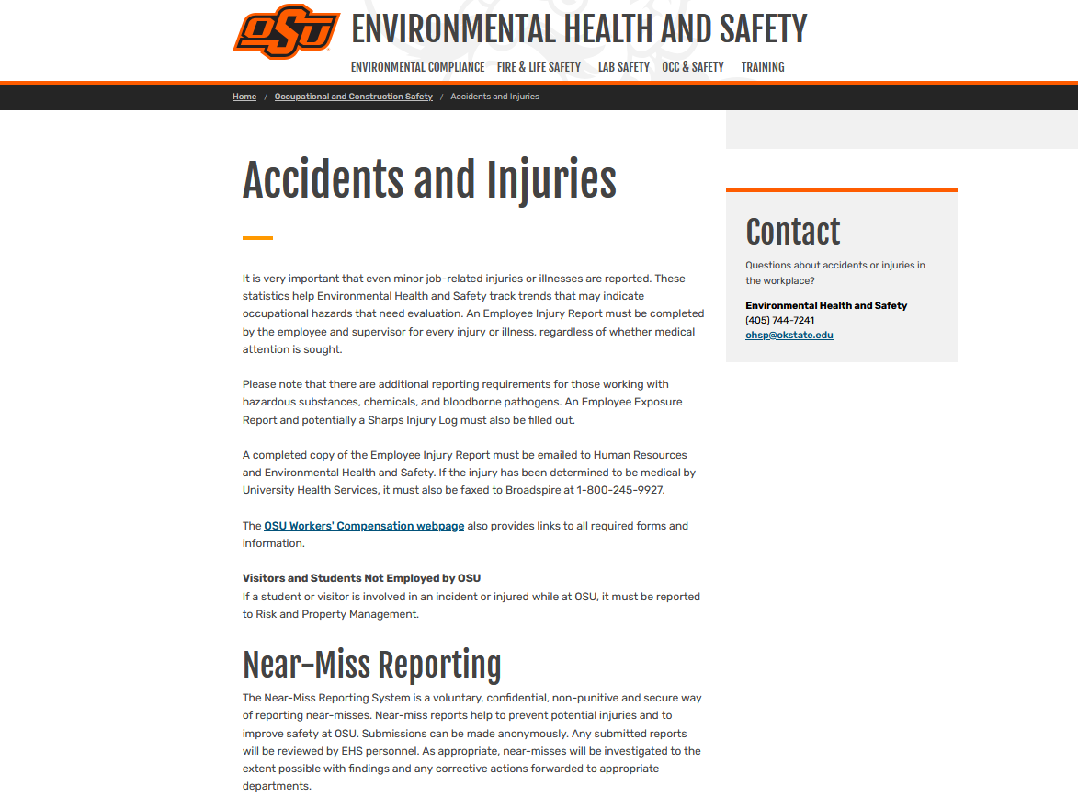
What happens after an accidental exposure - Forms

Slide 43
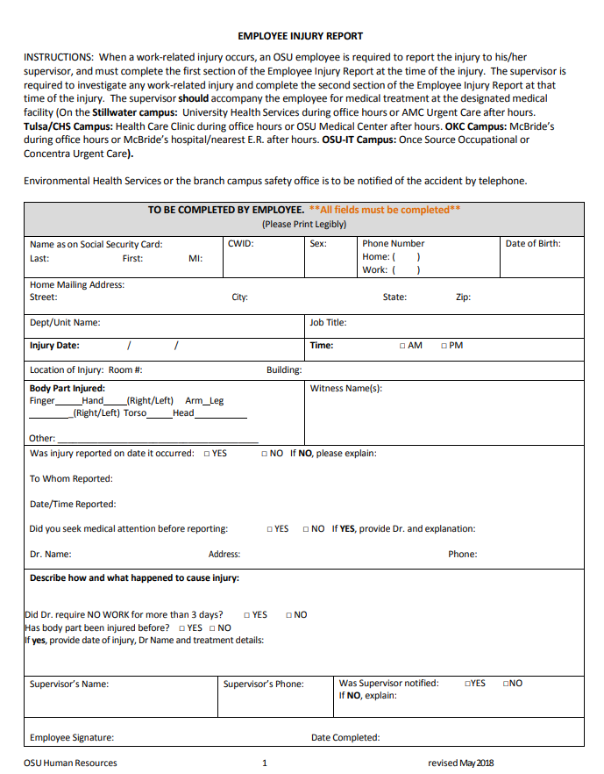
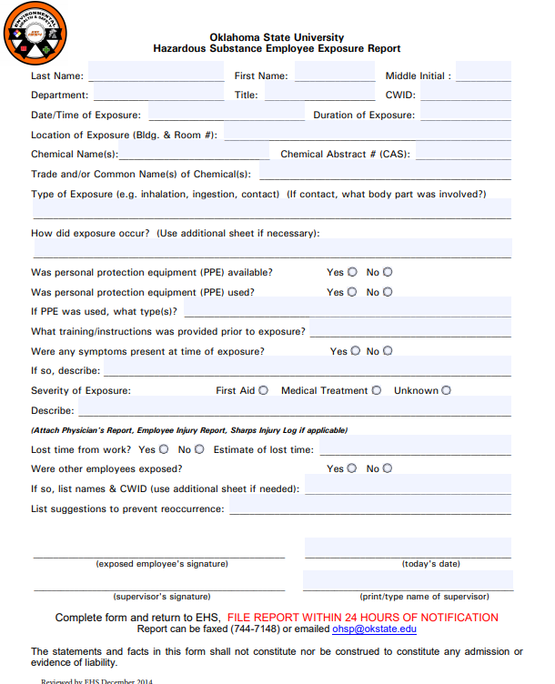
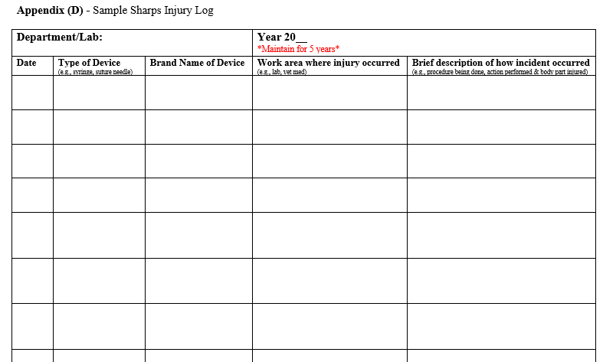
What happens after an accidental exposure - Forms

Slide 44
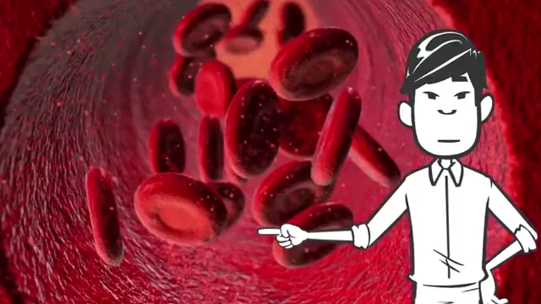
Review Video

Slide 45
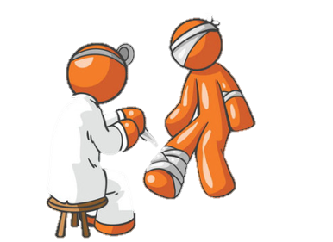
Precautions for Providing First-Aid to a Co-Worker
If possible, always have the patient self-administer first aid.
If they cannot self-administer, protect yourself before offering assistance by:
Wearing clean, leak-proof gloves
Being aware of personal cuts or broken skin
Protecting your nose and mouth in the event of splatters or sprays
If you do get blood or OPIM on yourself, immediately wash exposed area with soap and water.
If you get blood or OPIM in your eyes or mucous membranes, flush the area with running water for at least 15 minutes.

Slide 46
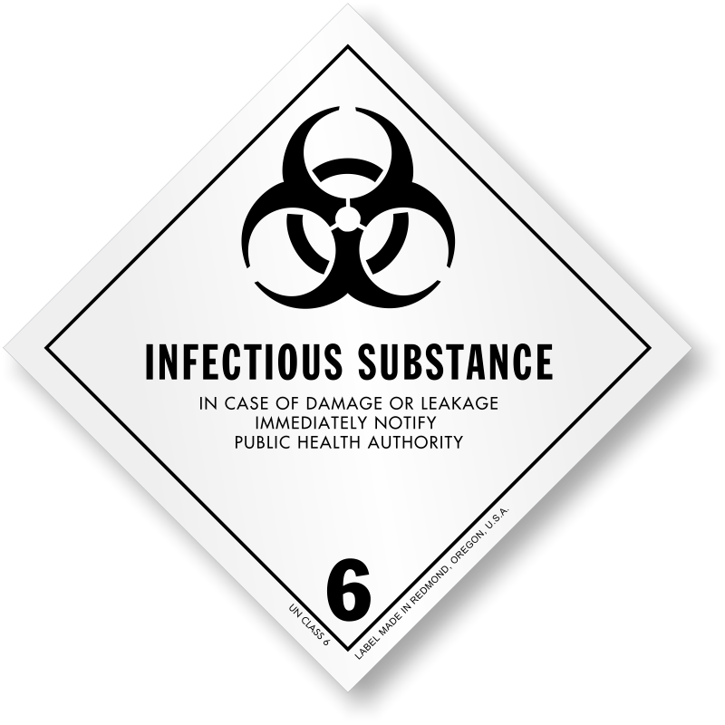
BBP and the US Department of Transportation
The shipping of infectious substances is highly regulated by the US Department of Transportation (49 CFR 173.134)
The US DOT classifies infectious substances into two categories:
  Category A Infectious Substances – Capable of causing permanent disability or life-threatening or fatal disease in otherwise healthy humans or animals when exposure to it occurs.
  Category B Infectious Substances – Generally capable of causing permanent disability or life-threatening or fatal disease in otherwise healthy humans or animals when exposure to it occurs.

Slide 47

BBP and the US Department of Transportation
Do you perform any of the following tasks:
  Determine the hazard class of an infectious substance to be shipped?
  Select packaging for an infectious substance to be shipped?
  Package an infectious substance?
  Secure a closure on an infectious substance package?
  Label a package to indicate it contains an infectious substance?
  Certify that an infectious substance is in proper condition for transportation?
  Load an infectious substance package into a transport vehicle?
If yes, you must complete training for infectious material shipping.

Slide 48
What should you take away?
Bloodborne pathogen rules are in place for your health and safety
Failure to follow these rules is an unnecessary risk that shouldn’t be taken
“Better safe than sorry"

Slide 49
Let’s Play a Game
1 | 2 | 3 | 4 | 5 | 6
1 | 2 | 3 | 4 | 5 | 6
1 | 2 | 3 | 4 | 5 | 6

Slide 50
What is a bloodborne pathogen?
A micro-organism carried in the blood that can cause disease in humans.

Slide 51
How are bloodborne pathogens transmitted?
Through blood or other potentially infectious materials.

Slide 52
What year was the OSHA BBP standard created?
1992
Last updated in 2001.

Slide 53
Name a profession that commonly comes into contact with BBPs
First Responder
Laboratory Worker
Housekeeping
Facilities Maintenance
Health Care Worker

Slide 54
What are the two modes of transmission?
Direct Contact and Indirect Contact

Slide 55
Which form of Hepatitis is commonly a short-term infection?
Hepatitis B

Slide 56
Which form of Hepatitis is commonly a long-term infection?
Hepatitis C

Slide 57
HIV is most commonly passed on through which mode of transmission?
Direct Contact

Slide 58
Does the OSHA standard only cover Hepatitis B, Hepatitis C, and HIV?
No

Slide 59
What does an engineering control do?
Isolates workers from the hazard.

Slide 60
What are administrative/workplace controls?
Rules put in place for how you do your work.

Slide 61
Name a type of PPE
Gloves
Lab Coat
Face Mask/Shield
Respiratory Protection
Special/Closed-Toe Shoes
Protective Suits

Slide 62
What color should a biohazard label be?
Fluorescent orange or red-orange.

Slide 63
What’s the main rule of universal precautions?
Treat all blood and OPIM as if they are infectious.

Slide 64
Do you have to pay for your own medical care after an exposure incident?
No. All medical care is paid for by your employer.

Slide 65
What’s the first rule of providing first aid to someone?
Have the patient self-administer first aid if possible.

Slide 66
Who do you contact if you ever have questions about BBPs on campus?
OSU’s Environmental Health and Safety office.

Slide 67
Is it ok to reuse disposable gloves if they are clean?
No. It is never ok to reuse disposable gloves!

Slide 68
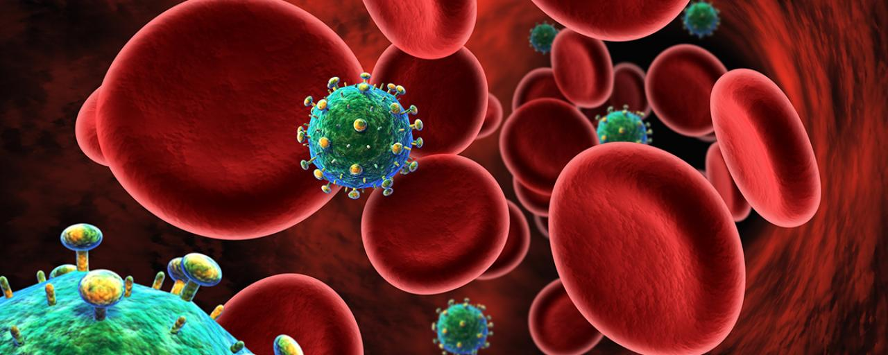
Questions?
Oklahoma State University
Environmental Health and Safety
744-7241

Slide 69
Environmental Health and Safety
Programs and services:
Fire Protection Engineering
Life Safety and Emergency Preparedness
Laboratory Safety
Occupational Safety
Occupational Health and Medical Surveillance
Materials Management
Industrial Hygiene
Chemical Hygiene
Safety Training
Location: University Health Services Building, Room 002 (Basement)
Phone Number: 405-744-7241
Email: EHS@okstate.edu
Website: http://ehs.okstate.edu

