Slide 1


FIRE SAFETY
OKLAHOMA STATE UNIVERSITY
Current as of January 2025

Slide 2

OBJECTIVES
Types of fires
Fire triangle/tetrahedron
Evacuation
Fire prevention
Types of extinguishers
How to use an extinguisher
Rules for fires

Slide 3
WHY FIRE SAFETY IS IMPORTANT
According to the US Department of Labor, workplace fires and explosions kill approximately 200 and injure more than 5,000 workers each year

Slide 4
CLASS OF FIRES
Fires are classified by the type of fuel they burn.
The five types are
A
B
C
D
K

Slide 5

CLASS A FIRES
Wood
Paper
Plastic
Rags

Slide 6

CLASS B FIRES
Gasoline
Oil
Grease
Paint

Slide 7

CLASS C FIRES
Electrical fires
  Office equipment
  Motors
  Switchgear
  Heaters

Slide 8

CLASS D FIRES
Metals
  Potassium
  Sodium
  Aluminum
  Magnesium

Slide 9

CLASS K FIRES
Kitchen fires
  Cooking grease
  Vegetable oils and fats
  Animal oils and fats

Slide 10
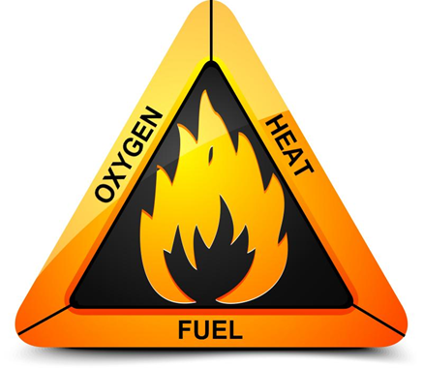
FIRE TRIANGLE/TETRAHEDRON
A fire requires
  Oxygen
  Fuel
  Heat
  Uninhibited chemical chain reaction

Slide 11
OXYGEN
Air is required as a catalyst
It can be oxygen from the air OR from the fuel itself

Slide 12
FUEL
For a fire to start, there must be something to burn

Slide 13
HEAT
For a fire to start, there must be a heat or ignition source

Slide 14
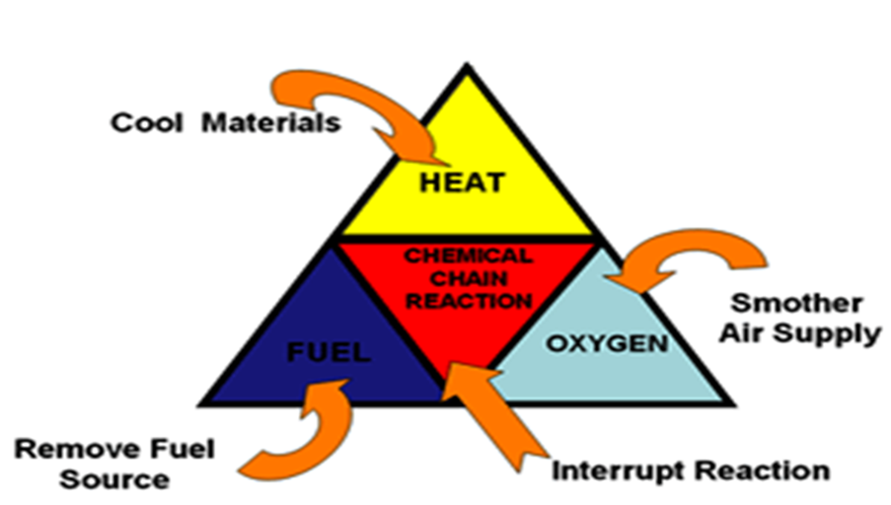
CHEMICAL CHAIN REACTION
When fire molecules bind together to form a fire

Slide 15
EVACUATION
FIRE PROCEDURES IN GENERAL CAMPUS BUILDINGS
Immediately activate the building fire alarm system
Assist any person in immediate danger to safety if it can be accomplished without risk to yourself
If the fire is small enough, use a nearby fire extinguisher to control and extinguish the fire. Don’t fight the fire if these conditions exist:
  The fire is too large or out of control (larger than the size of a small trash can)
  If the atmosphere is toxic

Slide 16
EVACUATION (cont.)
If the first attempts to put out the fire do not succeed, evacuate the building immediately
Doors, and if possible, windows should be closed as the last person leaves a room or area
When exiting through a closed interior door, check the door with the back of your hand for excessive heat in case the fire is on the other side
Do not use elevators – use building stairwells

Slide 17
EVACUATION (cont.)
When you hear the fire alarm sound, all persons in the building must evacuate immediately
Once outside of the building, cross the nearest street to allow emergency crews access. DIAL 911 from a safe location if emergency personnel have not arrived
Do not re-enter the building until given permission

Slide 18
EVACUATION (cont.)
IF YOU ARE TRAPPED IN SMOKE OR HEAT
Before you open any door, feel the door with the back of your hand. If the door is warm to the touch, DO NOT attempt to open the door
Stuff the cracks around doors with towels, rags, clothing or tape and cover vents to keep out smoke
Stay low to the floor and if possible, cover your mouth and nose with a damp cloth or dust mask to help you breathe
If there is a phone in the room where you are trapped, call 911 to tell them exactly where you are located
  Do this even if you see emergency personnel on the street below

Slide 19
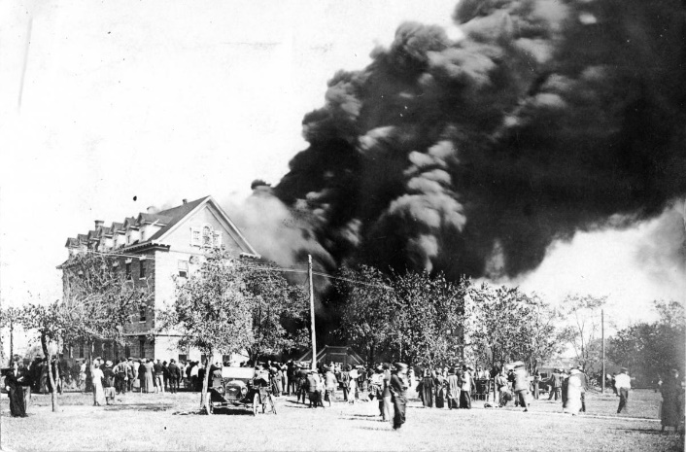
EVACUATION IF YOU ARE TRAPPED IN SMOKE OR HEAT (cont.)
Wait at a window and signal for help. Do not panic or jump! WAIT!
If possible, open the window at the top or bottom, but do not break it. You may need to close the window if smoke rushes in
Be patient. Rescuing all the occupants of a building can take several hours
OSU Domestic Science
Building 1914

Slide 20
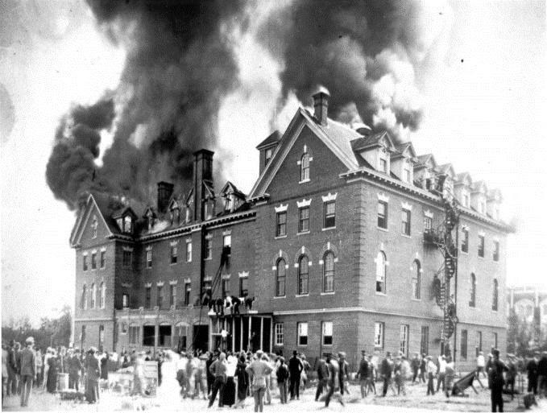
BE PREPARED
Check the location of fire alarms and know how they work
Learn your building evacuation plan
Know where your two nearest exits are located
Know how doors swing and where stairs lead
Make sure nothing blocks fire pulls, extinguishers and emergency exits
Learn the sound of your building fire alarm
Post emergency numbers (including security and first aid) near your telephone
OSU Morrill Hall Fire
1914 Boys Dormitory

Slide 21
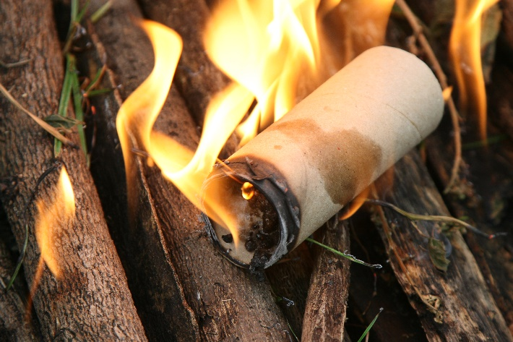
FIRE PREVENTION
Class A Fires:
Make sure combustible materials do not come in contact with potential heat sources such as floor furnaces, pilot lights, light bulbs, space heaters and electrical sources
Practice good housekeeping. Don’t let piles of newspapers or oily rags build up
Dispose of cigarettes properly
Keep matches and other lighters away from children

Slide 22
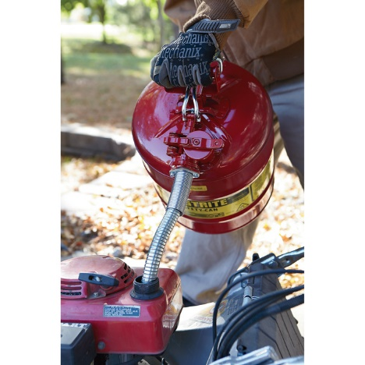
FIRE PREVENTION (cont.)
Class B Fires:
Always be careful when using flammable or combustible liquids. Most of these liquids emit fumes that are heavier than air. These fumes can travel long distances and may be ignited by ignition sources such as pilot lights, electrical sparks, or even static discharges
Store gasoline in approved safety cans only
Wait until gasoline powered equipment has cooled off before refueling

Slide 23
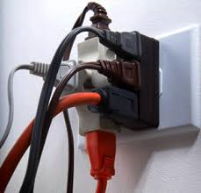
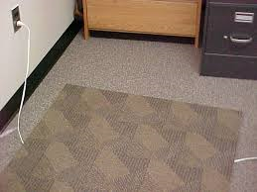
FIRE PREVENTION (cont.)
Class C Fires:
Don’t overload wall outlets
Make sure cords and wires are in good condition
Replace them if they become frayed or damaged
Don’t run cords under carpets or through doors or windows

Slide 24
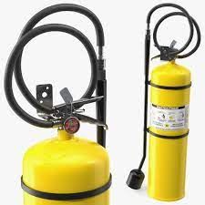
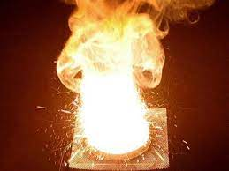
FIRE PREVENTION (cont.)
Class D Fires:
Involve combustible metals like Magnesium, Aluminum, Titanium, Sodium, Lithium, etc.
Care must be taken when handling or machining
These type of fires are extinguished by removing the oxygen by smothering the material
Common extinguishing agents may cause the severity of the fire to increase

Slide 25
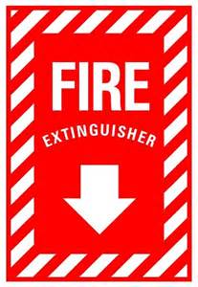
TYPES OF EXTINGUISHERS
Types of fire extinguishers are classified by the type of fires on which they may be used

Slide 26
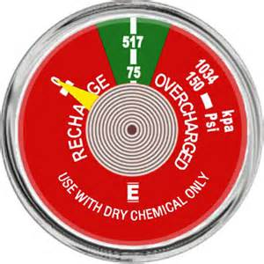
FIRE EXTINGUISHER GAUGE

Slide 27
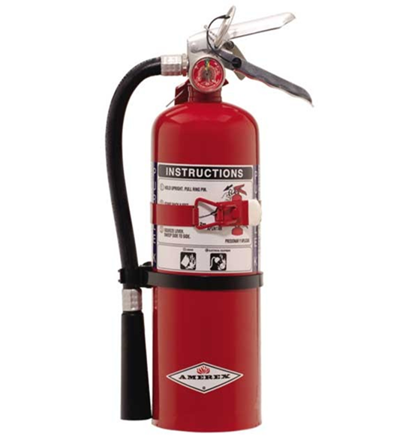
CLASS A
Used on
Wood
Paper
Plastic
Dry Chemical

Slide 28
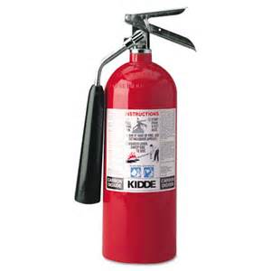
CLASS B
Used on flammable liquid fires
Carbon Dioxide (CO2)
Dry Chemical

Slide 29
CLASS C
Used on electrical fires
Carbon Dioxide (CO2)
Dry Chemical

Slide 30
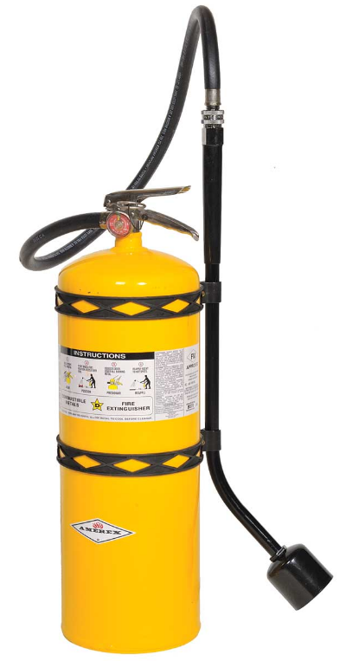
CLASS D
Used on metal fires
Extinguishing Agent Sodium Chloride

Slide 31
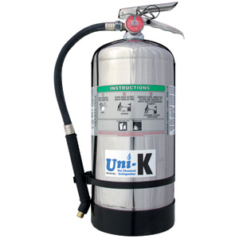
TYPE K
Used in commercial kitchens to extinguish boiling oil fires
Extinguishing Agent Potassium Acetate

Slide 32
In the event of a fire, your personal safety is your most important concern
Remember – you are not required to fight a fire.

Slide 33
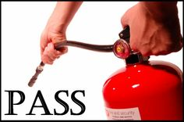
USING A FIRE EXTINGUISHER
Use the PASS System

Slide 34
PASS
Pull
Aim
Squeeze
Sweep

Slide 35
PULL
Pull the pin
  This will allow you to discharge the extinguisher

Slide 36
AIM
Aim at the base of the fire
  If you aim at the flames, the extinguishing agent will fly right through and do no good. You want to hit the fuel

Slide 37
SQUEEZE
Squeeze the top handle or lever
  This depresses a button that releases the pressurized extinguishing agent in the extinguisher

Slide 38
SWEEP
Sweep from side to side until the fire is completely out

Slide 39

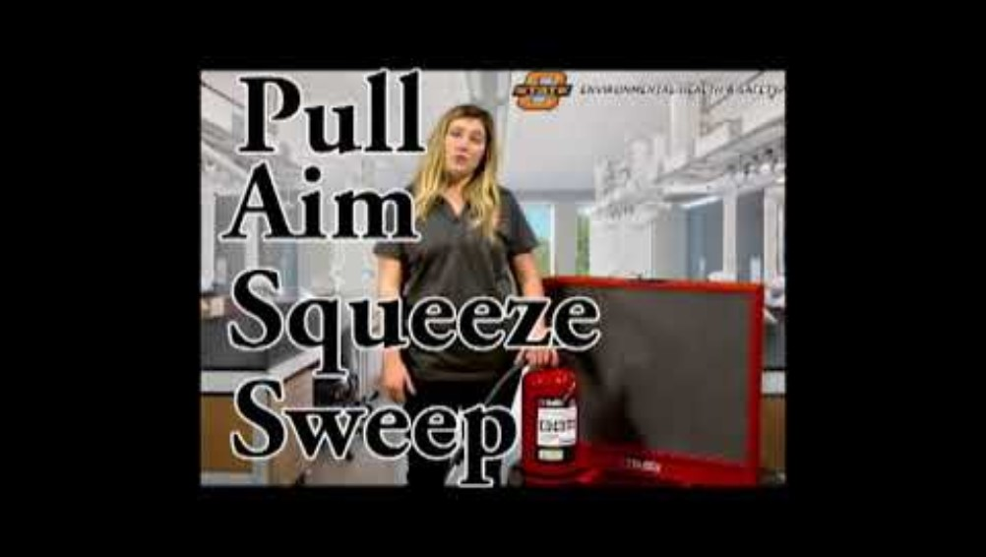
DEMONSTRATION
PORTABLE FIRE EXTINGUISHER

Slide 40
FIRE RULES
Fires are very dangerous
Be certain that you will not endanger yourself or others when attempting to put out a fire

Slide 41
FIRE RULES (cont.)
Pull the fire alarm
  Located at exterior doors primarily used as exits
Call 911
  State the emergency
  Location (address or name of location if possible)
Assist anyone in danger
  People with physical disabilities
  Elderly
  Children

Slide 42
FIRE RULES (cont.)
Never fight a fire if you don’t know what is burning
If you don’t know what is burning, you don’t know what type of extinguisher to use
Even if you have an ABC extinguisher, there may be something in the fire which is going to explode or produce highly toxic smoke

Slide 43
FIRE RULES (cont.)
Never fight a fire if the fire is spreading rapidly beyond the spot where it started
The time to use an extinguisher is in the beginning stages of a fire. If the fire is already spreading quickly, it is best to simply evacuate the building, closing doors and windows behind you as you leave

Slide 44
FIRE RULES (cont.)
Never fight a fire if you don’t have adequate or appropriate equipment
If you don’t have the correct type or large enough extinguisher, it is best not to try to fight the fire

Slide 45
FIRE RULES (cont.)
Never fight a fire if you might inhale toxic smoke
If the fire is producing large amounts of smoke that you would have to breathe in order to fight, it is best not to try
Gases from man-made materials can be fatal in very small amounts

Slide 46
FIRE RULES (cont.)
The final rule is to always position yourself with an exit or means of escape at your back before you attempt to use an extinguisher to put out a fire
In case the extinguisher malfunctions or something unexpected happens, you need to be able to get out quickly and you don’t want to become trapped. Just remember, always keep an exit at your back

Slide 47
TAKEAWAYS
Types of fires
Fire triangle/tetrahedron
Evacuation
Fire prevention
Types of extinguishers
How to use an extinguisher
Rules for fires

Slide 48

PROGRAMS AND SERVICES
ENVIRONMENTAL HEALTH AND SAFETY
Fire Protection Engineering
Life Safety and Emergency Preparedness
Environmental Compliance
Laboratory Safety
Occupational Safety
Occupational Health and Medical Surveillance
Materials Management
Industrial Hygiene
Chemical Hygiene
Safety Training

Slide 49

Environmental Health & Safety
Oklahoma State University
O | 405.744.7241
E | ehs@okstate.edu
UHS Suite 002
ehs.okstate.edu

Slide 50
QUESTIONS?

