Slide 1


OFFICE ERGONOMICS
OKLAHOMA STATE UNIVERSITY
Current as of April 2025

Slide 2

OBJECTIVES
What is Contact Stress, Force, Repetition
Musculoskeletal Disorders (MSD) Signs and Symptoms
Working Postures
Computer and Office Equipment Set-up
Hand and Ergonomics issues
Lap Top Ergonomic Guidelines

Slide 3

OFFICE ERGONOMICS AND OSHA

Slide 4
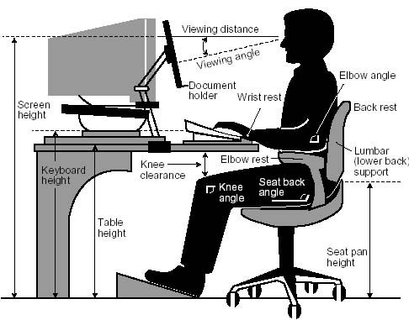
OFFICE ERGONOMICS
There is not a single “correct” posture or arrangement of components that will fit everyone
However, there are basic design goals, some of which are shown in the accompanying figure, to consider when setting up a computer workstation or performing computer-related tasks

Slide 5
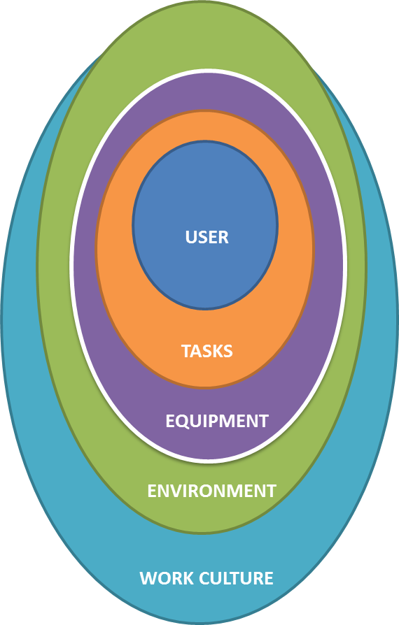
OFFICE EGONOMICS
The science of “designing the job to fit the worker, not forcing the worker to fit the job”
Ergonomics covers all aspects of jobs:
  Physical stress placed on joints, muscles, nerves, tendons, bones, etc.
  Environmental factors affecting hearing, vision, and general comfort and health
  Enhanced comfort
  Increased productivity
  Improved job satisfaction and morale
  Reduced musculoskeletal discomfort, work injuries/illnesses

Slide 6
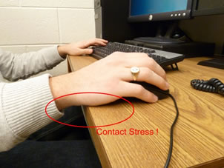
CONTACT STRESS
You can experience contact stress to your forearms when you rest them on the leading edges of worktables. Nerves in the forearm are affected, your fingers and hands may tingle and feel numb, similar to the feeling when you hit your “funny bone.”
You may experience pain and numbness in your legs if blood circulation is cut off by contact with the leading edge of a chair.
Your forearms and wrists can be affected if wrist rests have sharp, hard leading edges.
Tendons can be damaged when repetitive finger motion
tasks are performed with a bent wrist.

Slide 7

FORCE
Your finger and forearm muscles may become sore if you use a pointing device at a setting that is so sensitive that it is hard to control. Hand and arm muscles must work continually to keep the device steady.
Your shoulder and neck muscles are continually being used to lift the arm away from your body if the mouse is placed too far away.
The muscles of the back can become strained if you must tilt your head back to view a monitor that is too high.

Slide 8
REPETITION
Computers require little task variation. Old typing activities, such as adding paper or mechanically advancing pages, have been reduced or eliminated. Users can stay in their chairs and type or perform mouse work for an almost unlimited amount of time. Under these conditions, a proficient typist can easily perform more than 18,000 keystrokes per hour. These repetitive motions can lead to tendon and tendon sheath injuries, especially if the wrist is bent during the activity.
Similar repetitions occur when using a pointing device such as a mouse. Here, the hazard may be greater because the motions are often concentrated in only a few fingers of one hand.

Slide 9

REPETITION
A computer operator may remain in essentially the same posture for an entire shift. This forces a few isolated muscles to repeatedly activate to accomplish a task such as holding the head up or focusing on a computer screen.
A poorly designed workstation may cause you to repeatedly reach to use a mouse or answer the phone. This can fatigue the muscles of the shoulder and irritate the tendons.

Slide 10

REDUCING REPETITION
Task Rotation or Job Enlargement
  If you perform a variety of tasks, when possible, intersperse them throughout the work day. Minimize long blocks of uninterrupted computer time by doing other non-computer tasks such as photocopying, phone work, cleanup, etc.
Micro Breaks or Rest Pauses
  Build short micro pauses into computer use sessions. Frequent short breaks are desirable. Every hour, take a five-minute break from computer tasks. Look away, stretch, get up, or walk. These brief pauses provide time for muscles and tendons to recover.

Slide 11

AWKWARD POSTURES
Muscles can be stretched or compressed causing them to be inefficient and resulting in possible fatigue and overexertion.
Non-neutral postures can pull and stretch tendons, blood vessels, and nerves over ligaments or bone where they can become pinched and restricted.
Tendons and their sheaths can rub on bone and ligaments, which can lead to irritation and fraying. This can lead to swelling within confined areas such as the carpal tunnel, which then restricts nerves and blood vessels.
Tingling and numbness of the fingers and hands as well as pain from tendinitis and tenosynovitis (inflammation of a tendon sheath) can result.

Slide 12
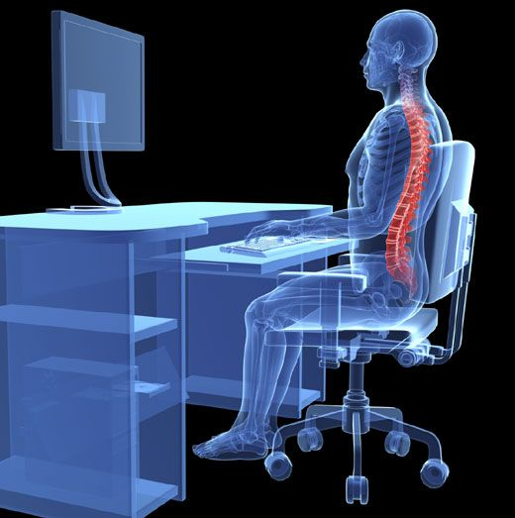
GOOD WORKING POSITIONS
Understand the concept of neutral body positioning.
A comfortable working posture in which your joints are naturally aligned.
Body in a neutral position reduces stress and strain on the muscles, tendons, and skeletal system and reduces your risk of developing a musculoskeletal disorder (MSD).

Slide 13
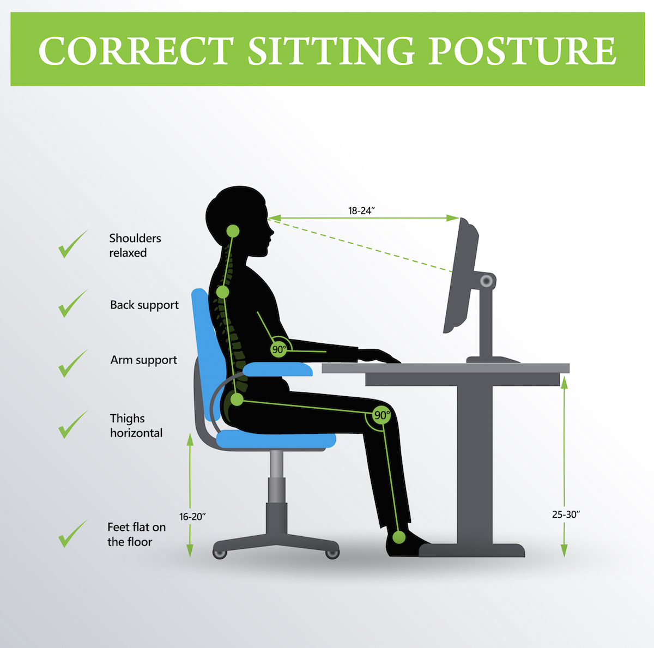
NEUTRAL BODY POSTURES
Hands, wrists and forearms
  Straight, in-line and roughly parallel to the floor
Head
  Is level, or bent slightly forward, forward facing and balanced. Generally, it is in line with the torso.
Shoulders
  Are relaxed and upper arms hang normally at the side of the body
Elbows
  Stay in close to the body and bent between 90 and 120 degrees

Slide 14
NEUTRAL BODY POSTURES
Feet
  Are fully supported by the floor, or a footrest may be used if the desk height is not adjustable
Back
  Is fully supported with appropriate lumbar support when sitting vertical or leaning back slightly
Thighs
  And hips are supported by a well-padded seat and generally parallel to the floor
Knees
  Are about the same height as the hips with feet slightly forward

Slide 15
WORKING POSTURE
Regardless of how good your working posture is, working in the same posture or sitting still for prolonged periods is not healthy. You should change your working position frequently throughout the day in the following ways:
  Make small adjustments to your chair or backrest.
  Stretch your fingers, hands, arms, and torso.
  Stand up and walk around for a few minutes periodically.

Slide 16
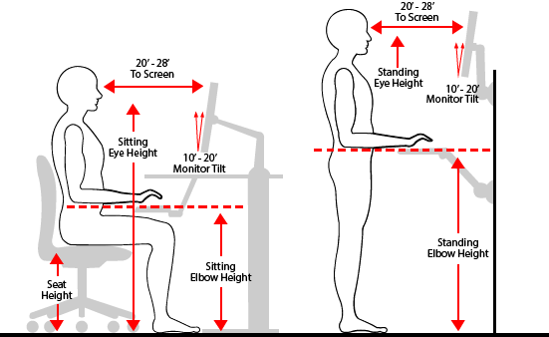
WORKING POSTURE

Slide 17
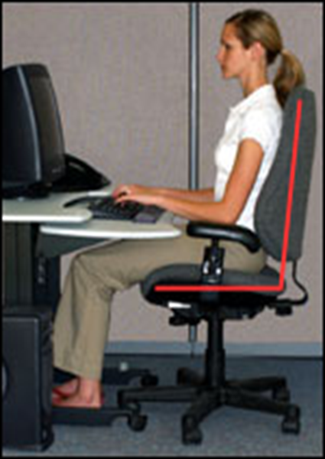
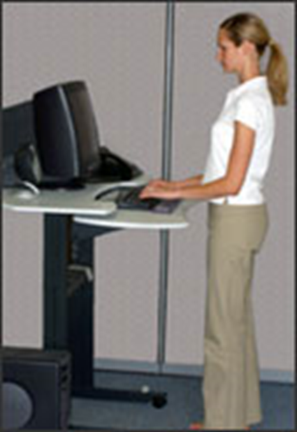
WORKING POSTURE
Upright sitting position
The user’s neck and torso are approximately vertical and in line. The thighs are approximately horizontal, and the lower legs are vertical
Standing
The user's legs, torso, neck, and head are approximately in-line and vertical. The user may also elevate one foot on a rest while in this posture.

Slide 18
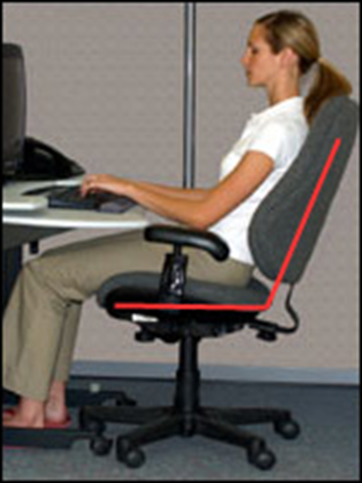
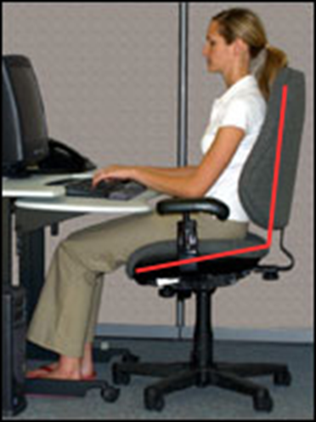
WORKING POSTURE
Declined sitting
The user's thighs are inclined with the buttocks higher than the knee and the angle between the thighs and the torso is greater than 90 degrees. The torso is vertical or slightly reclined and the legs are vertical
Reclined sitting posture
The user's torso and neck are straight and recline between 105 and 120 degrees from the thighs.

Slide 19
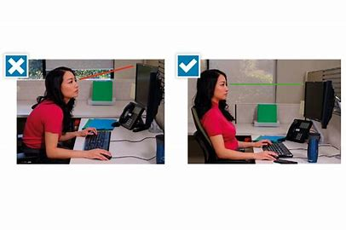
MONITOR
Put monitor directly in front of you and at least 20 inches away.
Place monitor so top line of screen is at or below eye level.
Place monitor perpendicular to window.

Slide 20
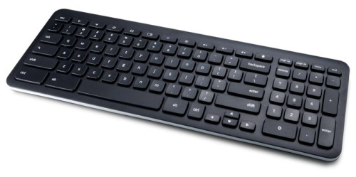
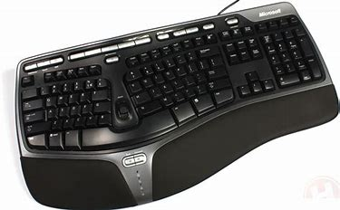
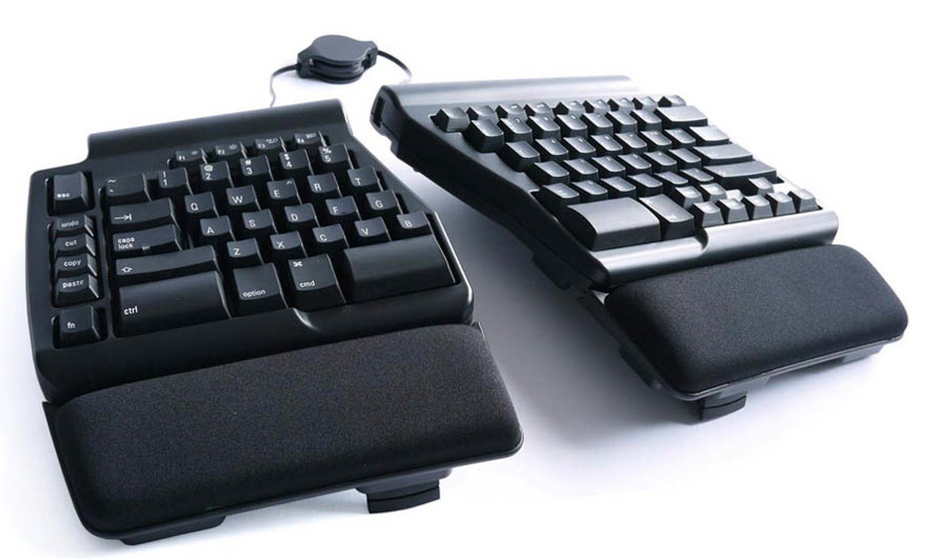
KEYBOARD
Put the keyboard directly in front of you.
Your shoulders should be relaxed and your elbows close to your body.
Your wrists should be straight and in-line with your forearms.

Slide 21
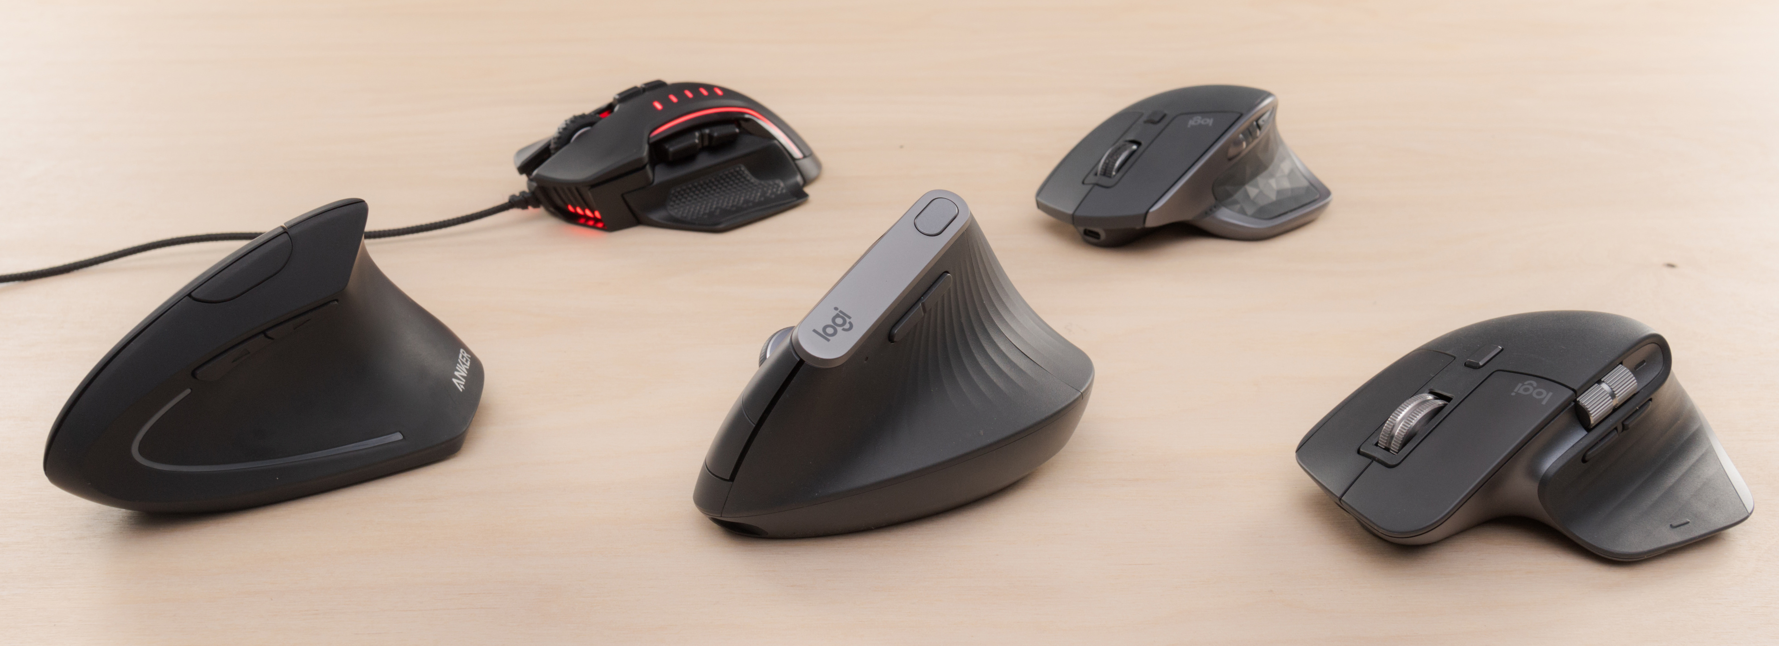
POINTING DEVICES
Keep the pointer/mouse close to the keyboard.
Alternate hands with which you operate the pointer/mouse.
Use keyboard short cuts to reduce extended use.
Pointers do come in various sizes.

Slide 22
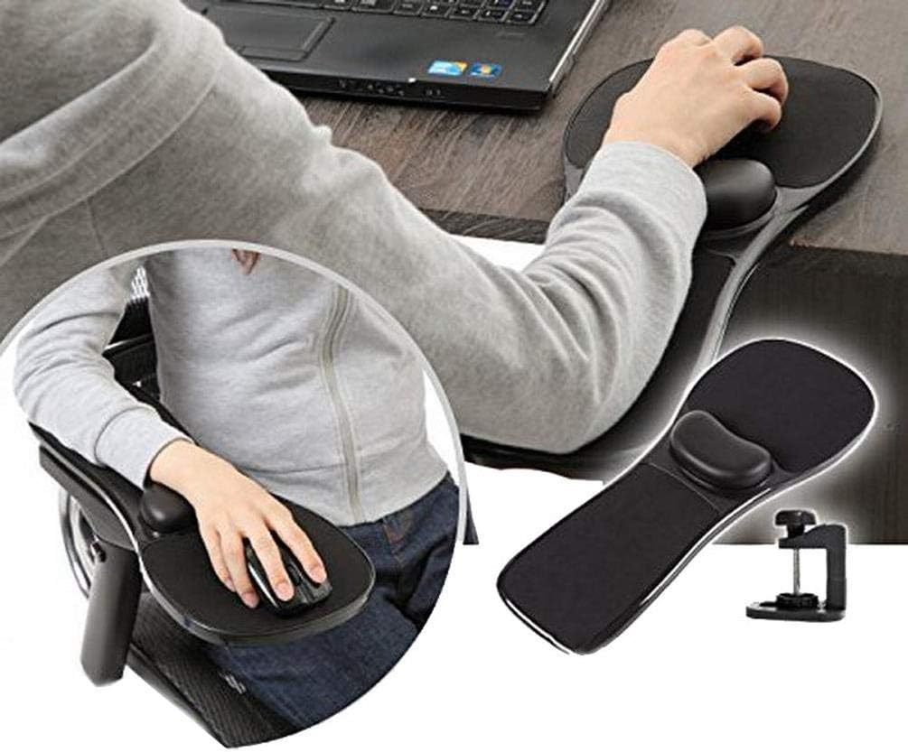
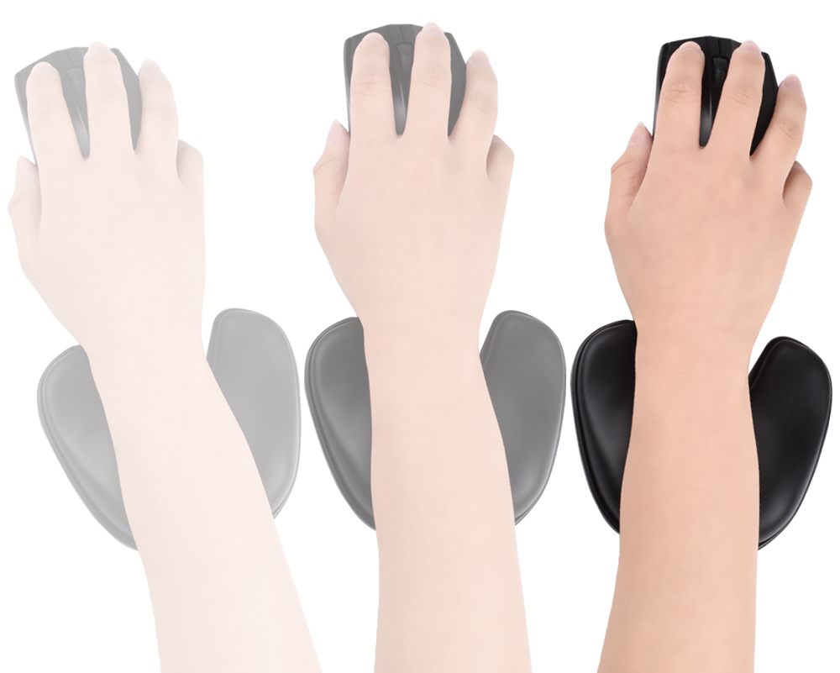
WRIST AND PALM SUPPORT
Use a wrist rest to maintain straight wrist postures and to minimize contact stress during typing and mousing tasks.

Slide 23
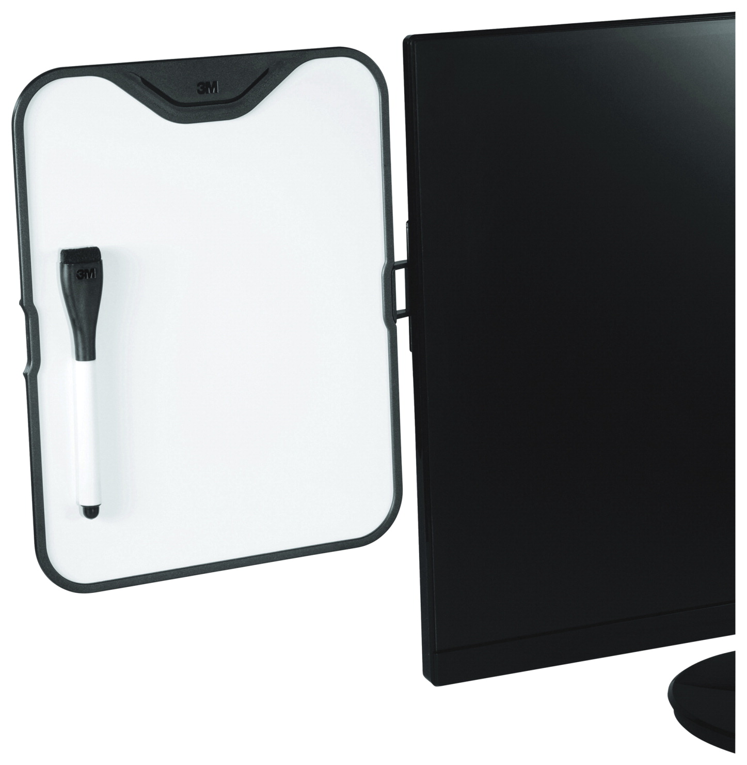

DOCUMENT HOLDERS
Documents should be at the same height and distance as the monitor.

Slide 24
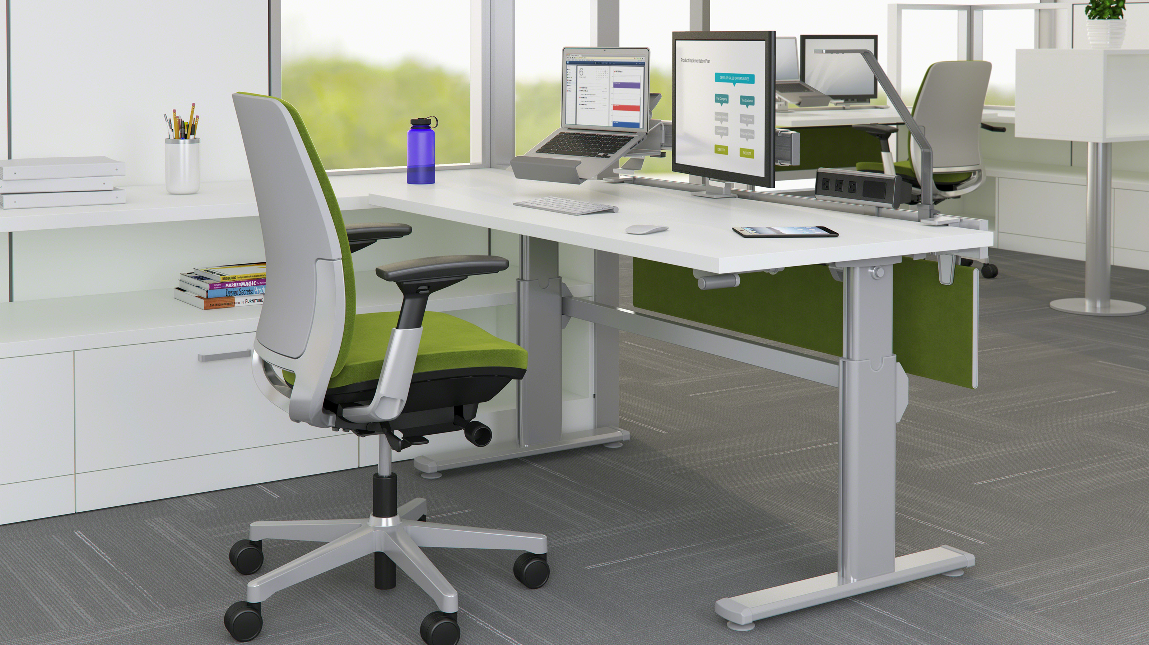
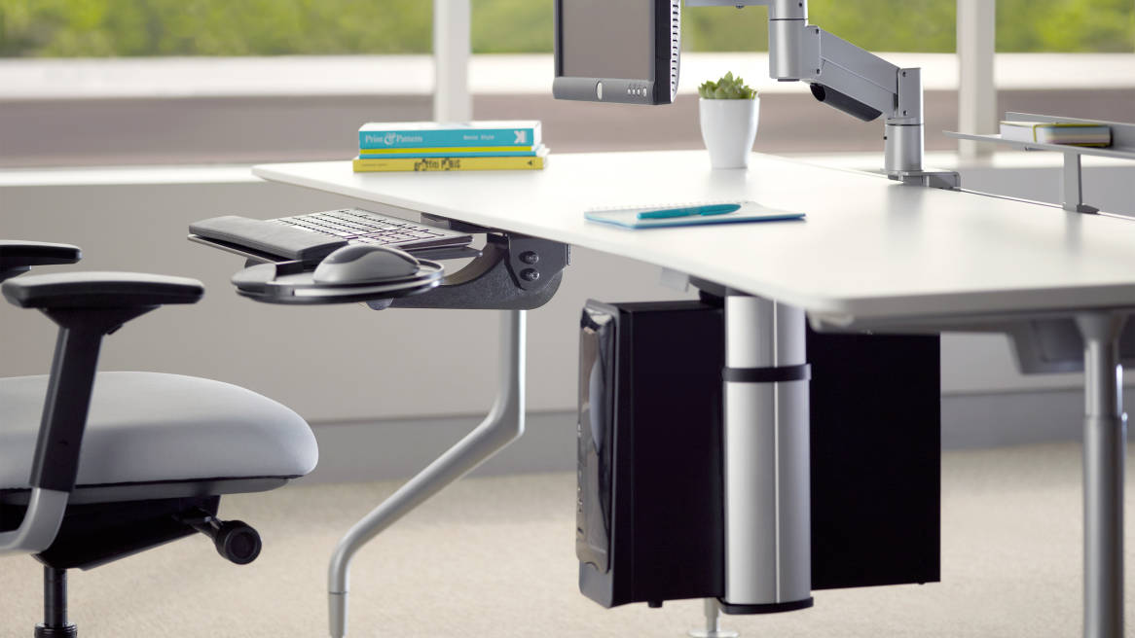
DESK
Desk surface should allow you to place the monitor directly in front of you, at least 20 inches away.
Avoid storing items on top of workspaces or under desks.
Desks should be able to accommodate a variety of working postures.

Slide 25
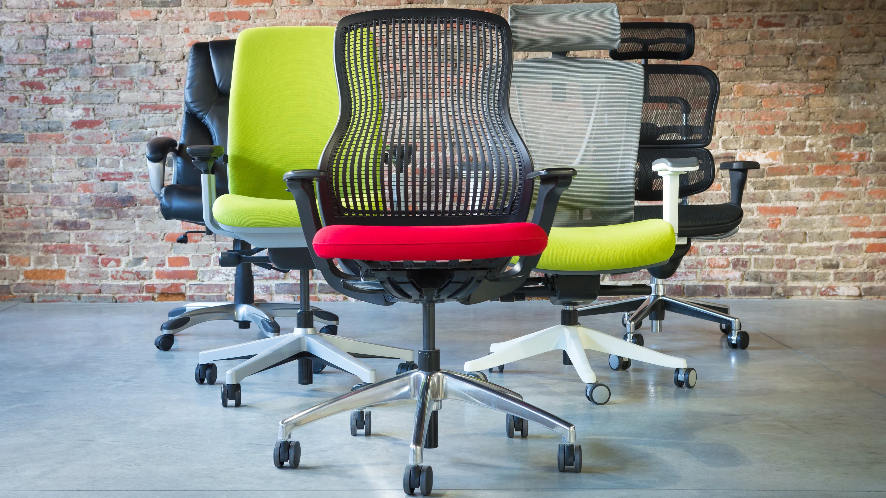
CHAIR
The backrest should conform to the natural curvature of your spine and provide adequate lumbar support.
The seat should be comfortable and allow your feet to rest flat on the floor or footrest.
Armrests, if provided, should be soft, allow your shoulders to relax and your elbows to stay close to your body.
The chair should have a five-leg base with casters that allow easy movement along the floor.

Slide 26
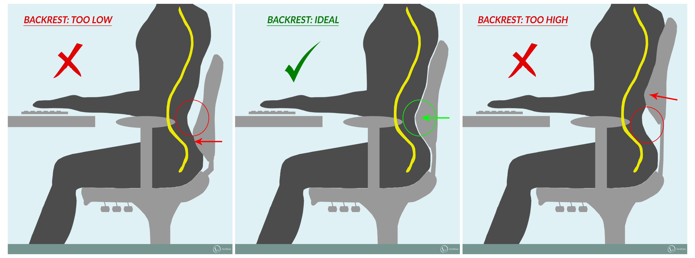
CHAIR

Slide 27
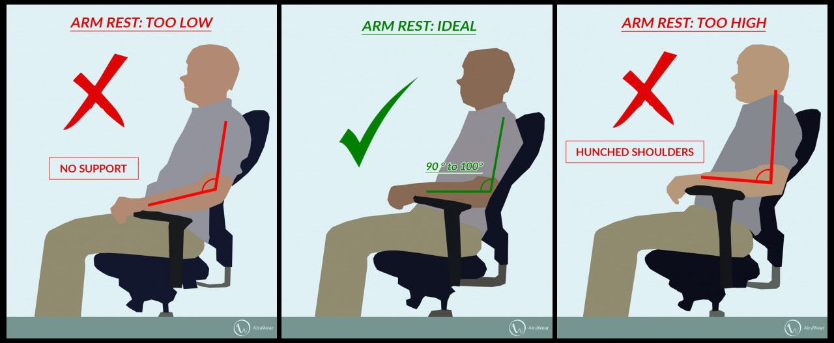
ARM REST

Slide 28

TELEPHONE
Use a speaker phone or head set for long conversations.
Keep it close enough to avoid repeated reaching.

Slide 29

WORKSTATION ENVIRONMENT
Arrange your office to minimize glare from overhead lights, desk lamps, and windows.
Maintain appropriate air circulation.
Avoid sitting directly under air conditioning vents that "dump" air right on top of you.

Slide 30
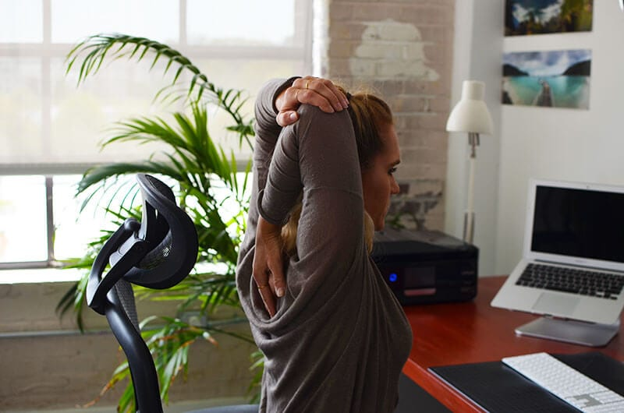
EXERCISES
High repetition tasks or jobs that require long periods of static posture may require several, short rest breaks (micro breaks). During these breaks users should be encouraged to stand, stretch, and move around. This provides rest and allows the muscles enough time to recover.
Alternate tasks whenever possible, mixing non-computer-related tasks into the workday. This encourages body movement and the use of different muscle groups.

Slide 31
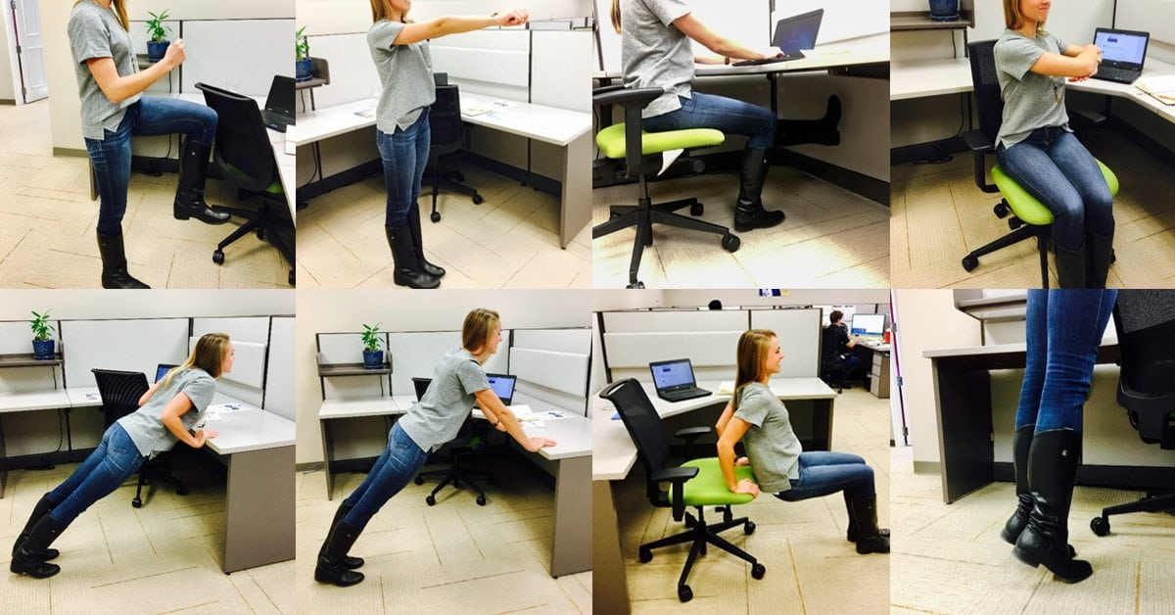
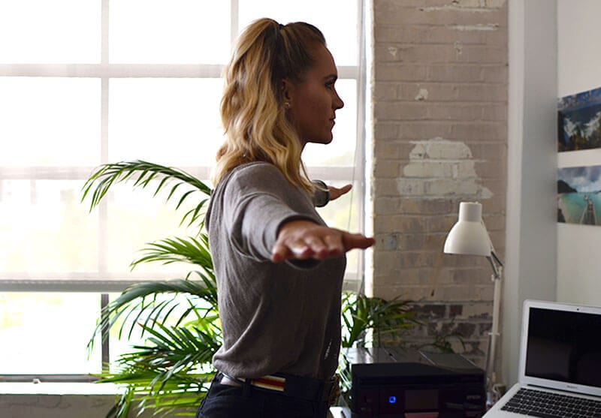
DESK EXERCISES
Blink!!! and exercise eye muscles frequently to avoid eye strain
Head rolls side to side and front to back
Shoulder shrugs
Arms over the head stretching side to side and backwards
Stretching legs outward off the floor
Ankle rolls
Seated knee raises

Slide 32
MSD’S SIGN SYMPTOM
Numbness or a burning sensation in the hand
Reduced grip strength in the hand
Swelling or stiffness in the joints
Pain in wrists, forearms, elbows, neck, or back
Reduced range of motion in the shoulder, neck, or back
Dry, itchy, or sore eyes
Blurred or double vision
Aching or tingling
Cramping
Weakness

Slide 33
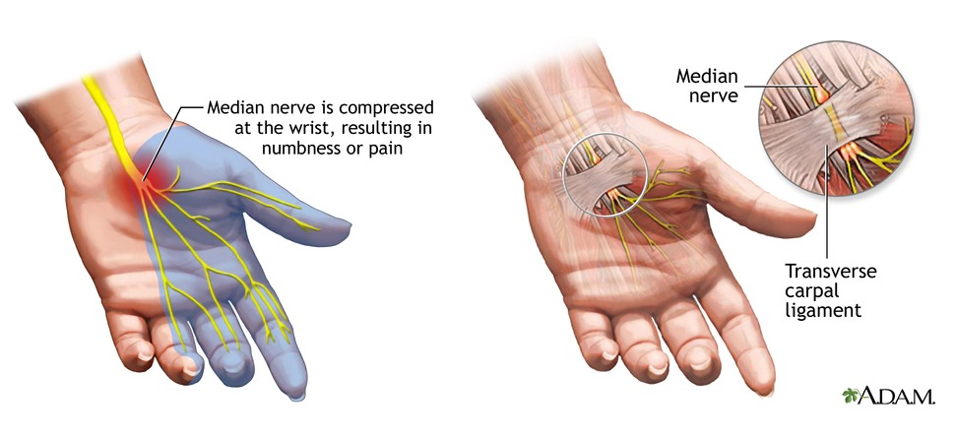
CARPAL TUNNEL, INSIDE OF WRIST
Inside view of wrist
Yellow nerve crosses under flexor retinaculum
Nerve has to share the space with nine tendons and tendon sheaths.

Slide 34
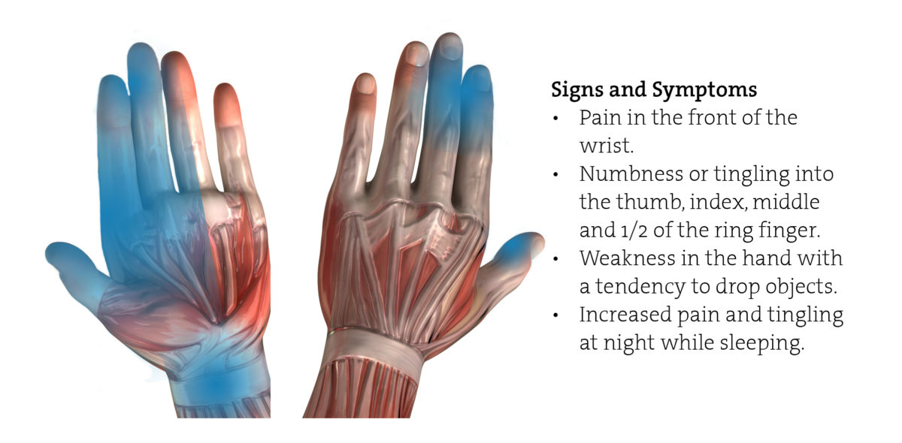
MEDIAN NERVE (CARPAL TUNNEL)

Slide 35
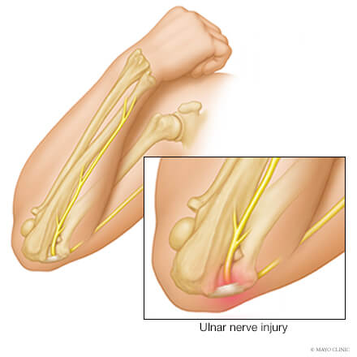

CUBITAL TUNNEL OR “FUNNY BONE”
The ulnar nerve passes by the inside of the elbow through a fibrous tunnel.
Swelling can put pressure on the ulnar nerve.
Symptoms are felt at the elbow and into the little finger.
This is called Cubital
Tunnel Syndrome.

Slide 36
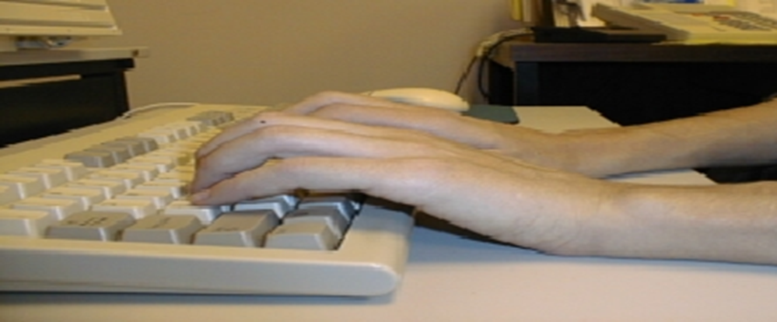
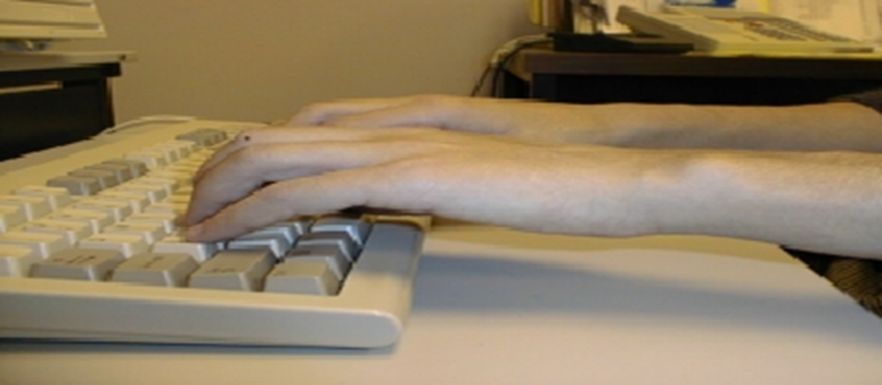
WATCH THE HAND MOVEMENTS
DON’T rest your wrists on the desktop
DO let your wrists float

Slide 37
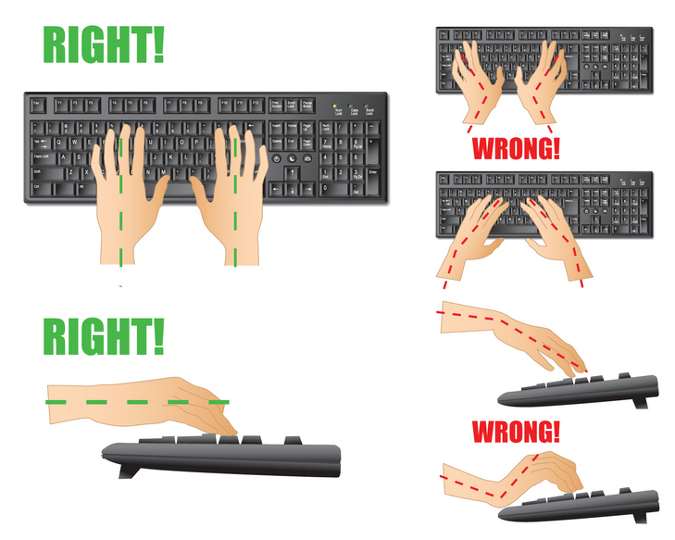
WATCH THE HAND MOVEMENTS

Slide 38
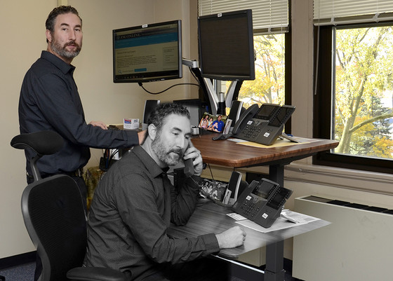
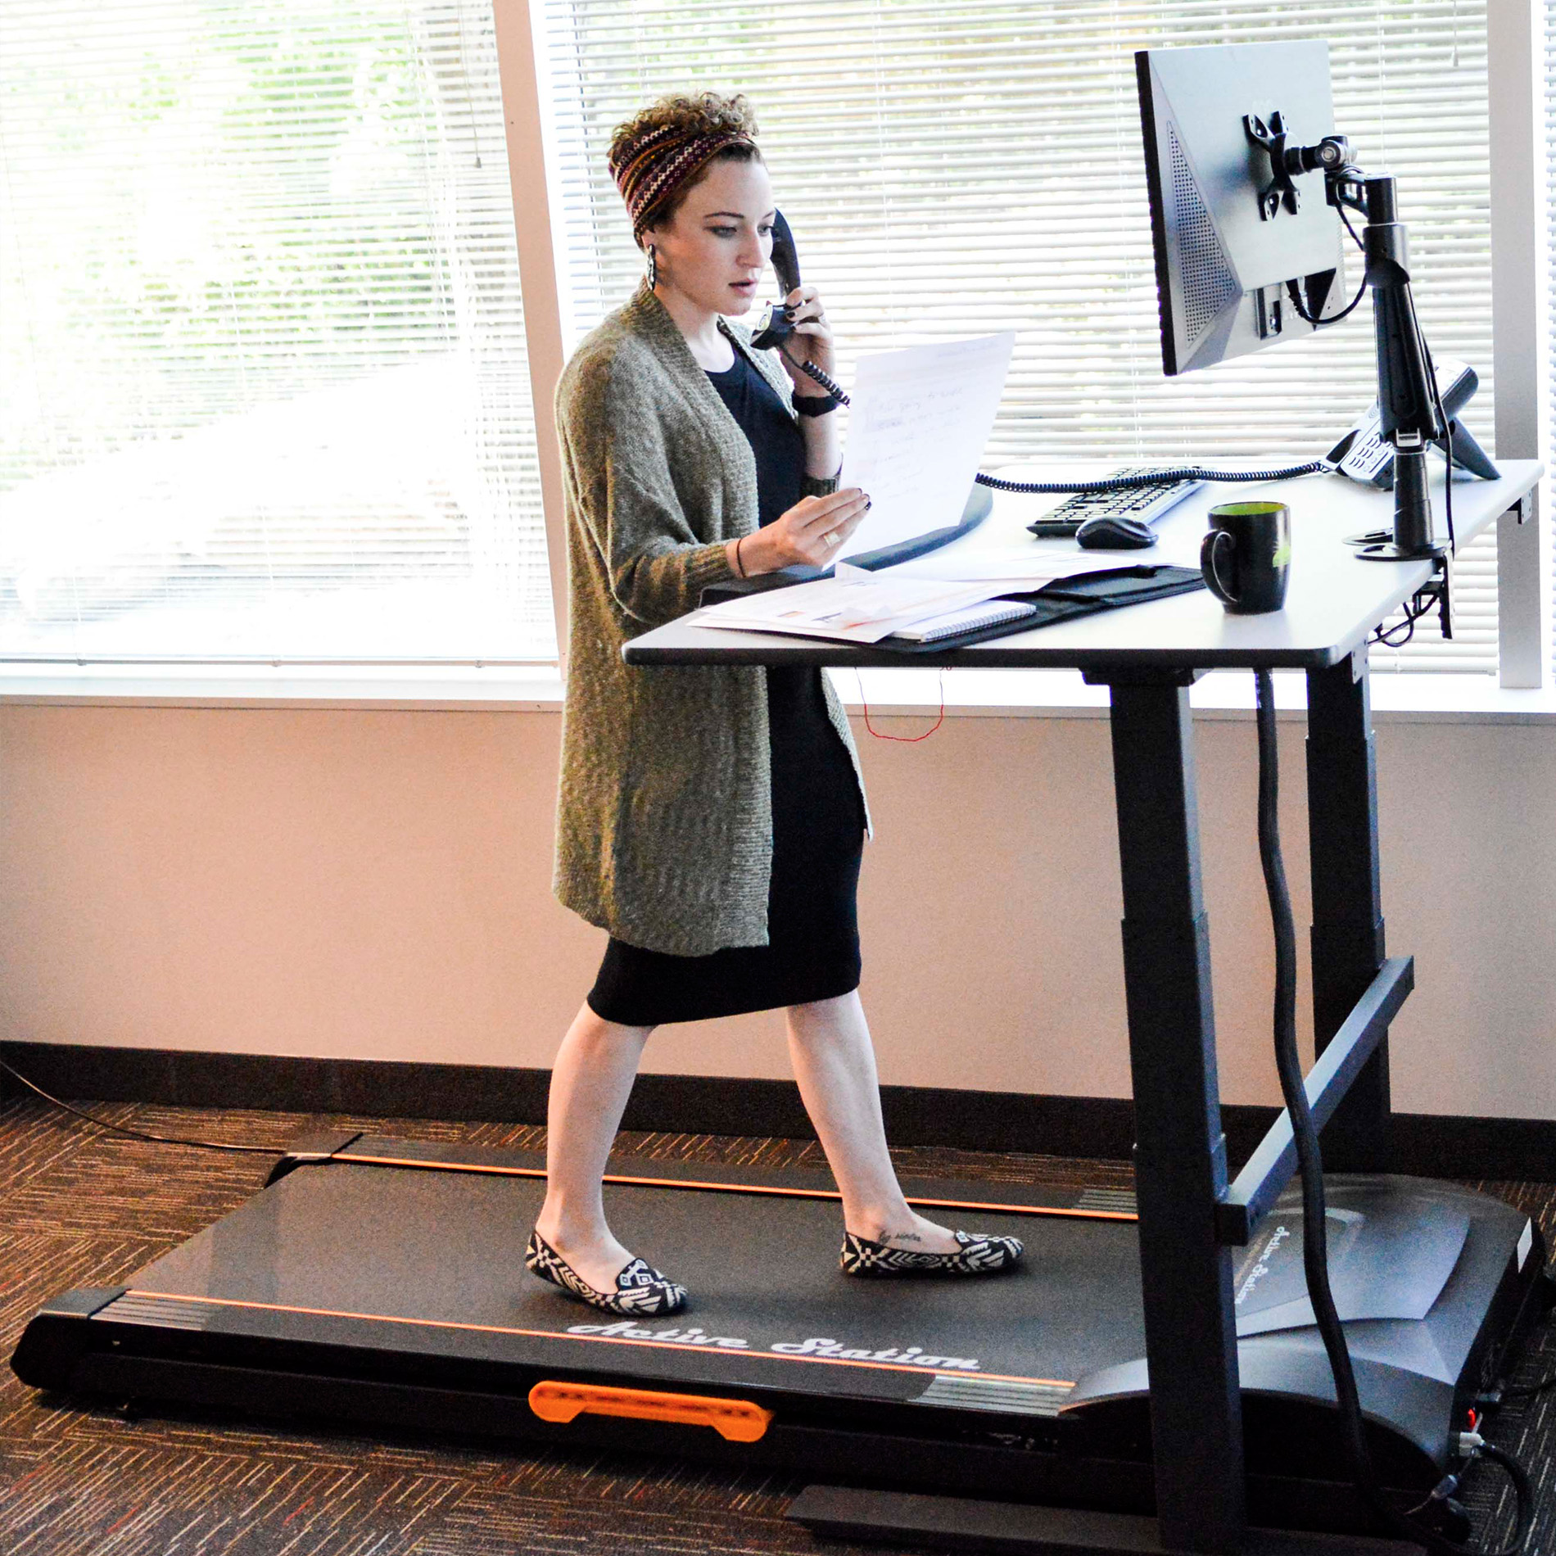
SIT, STAND, OR WALK

Slide 39

LAPTOP ERGONOMIC GUIDELINES
CENTERS FOR DISEASE CONTROL AND PREVENTION
The CDC recommends that laptop computers not be used as a primary computer at home or at work.
OCCASIONAL USERS SHOULD:
Find a comfortable chair
Use a neutral wrist position
Position screen to minimize neck bending

Slide 40
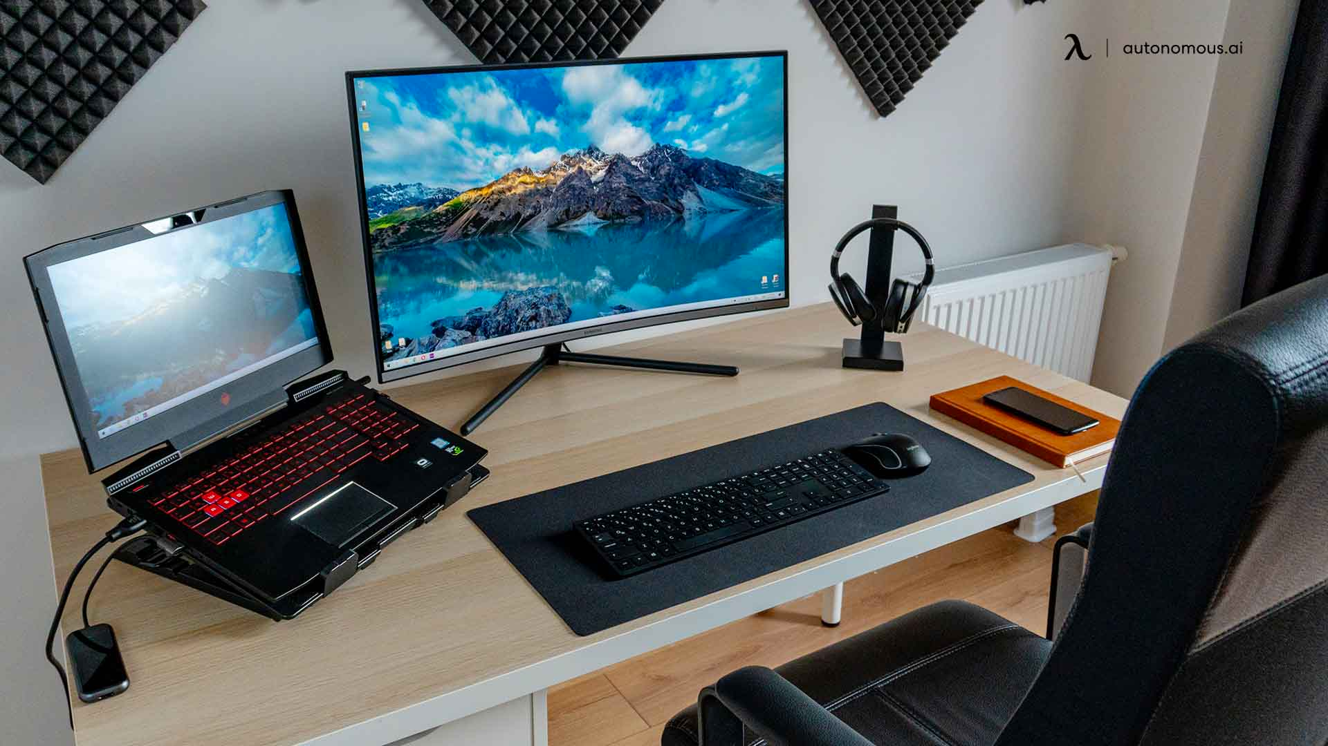
LAPTOP GUIDELINES
Take mini-breaks ever 20-30 minutes.
Keep viewing distance at 18-30 inches.
Position keyboard at elbow height.
If seated in a side-chair or couch, use a pillow to support your arms while keying.
Clean the screen regularly.
Consider using an external keyboard or docking station

Slide 41

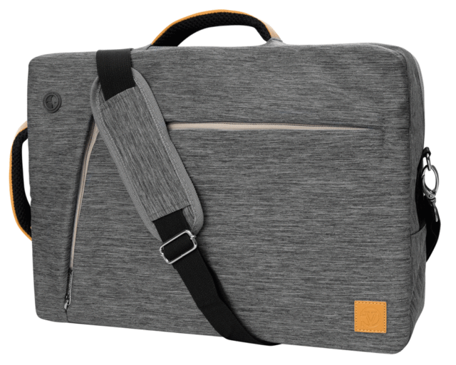
TRANSPORTING THE COMPUTER
If computer and accessories > 10 lbs, consider a bag with wheels.
Eliminate all unnecessary items from your briefcase.
Carry a laptop in a case with padded shoulder pad and handle.
Shift hands and shoulders to balance the load.

Slide 42

PROGRAMS AND SERVICES
ENVIRONMENTAL HEALTH AND SAFETY
Fire Protection Engineering
Life Safety and Emergency Preparedness
Environmental Compliance
Laboratory Safety
Occupational Safety
Occupational Health and Medical Surveillance
Materials Management
Industrial Hygiene
Chemical Hygiene
Safety Training

Slide 43

Greg Hogan
Environmental Health and Safety
O | 405.744.7241
E | ehs@okstate.edu
UHS Suite 002
ehs.okstate.edu

Slide 44
QUESTIONS?

