Slide 1


OFFICE SAFETY
OKLAHOMA STATE UNIVERSITY
Current as of Feb 2025

Slide 2

OBJECTIVE
Recognize potential hazards in office environments.
Identify ways to eliminate office environment hazards.
Learn and implement safe work practices.

Slide 3
INTRODUCTION
Office environments include many hazards and are the location for many accidents on the OSU campus each year.
Injuries in the office include:
Ergonomic and repetitive motion injuries
Back injuries from poor lifting and posture
Slips, trips, and falls
Allergies and indoor air quality illnesses
Cuts, burns, and crush injuries from office equipment and breakroom food prep

Slide 4
OFFICE SAFETY: BEST PRACTICES
Good housekeeping is essential.
Never leave desk or cabinet drawers open.
Never use chairs or desks to reach an overhead item.
Use safe lifting practices. Bend your knees and lift with your legs.
Ensure your computer is in a position that will eliminate eye strain.
Always know your exit path in case of emergency.

Slide 5
OFFICE ERGONOMICS
Design factors intended to maximize productivity by minimizing operator fatigue and discomfort.
Workstations should be designed to reduce excessive bending and stretching.
Office furniture should be fully adjustable to accommodate any employee.
Chairs should support the lower back and have an adjustable height.
Computer monitors should be placed directly in front of the user, with the top of the monitor at eye level to avoid neck strain.
Keyboards should be elevated in the back to keep wrists in a neutral position.

Slide 6
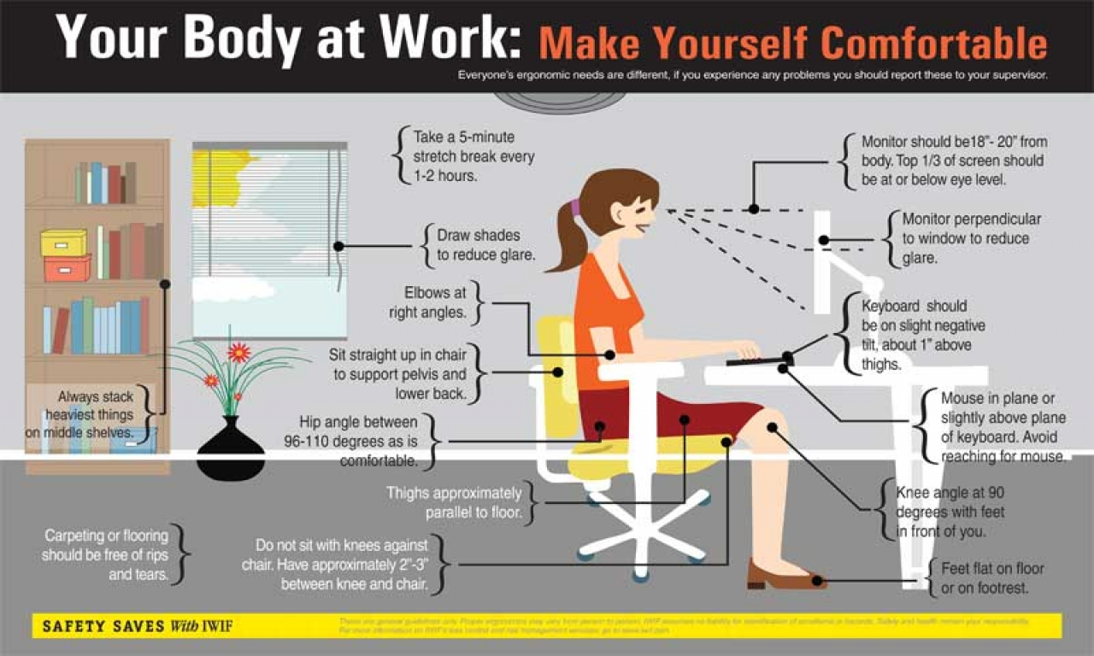

Slide 7
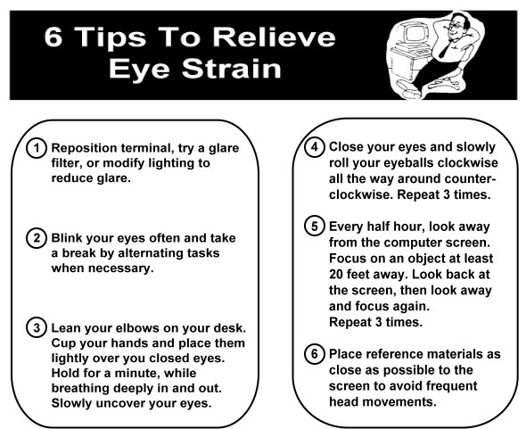
AVOIDING EYE STRAIN
In an office setting, your eyes are at risk of becoming strained from looking at computer screens for a long period of time. Use these tips to help prevent future eye problems.

Slide 8
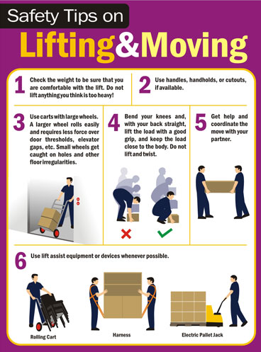
BACK SAFETY
Avoid lifting if you can and utilize hand trucks or rolling carts for heavy objects.
Keep heavy objects off the floor to reduce bending.
Test the weight of an object before lifting and enlist help if the object is too heavy.
Plan the lift prior to lifting. Determine where you are moving the object.
Bend at the knees and keep a straight back, carrying the load between the shoulder and waist.

Slide 9
SLIPS, TRIPS, AND FALLS
Prevention techniques:
Ensure electrical cords are out of areas of travel.
Clean any spills immediately or mark them with appropriate signage until the spill is cleaned.
Do not block passageways.
Keep office areas free of clutter.
Watch where you walk. Look for loose carpet, broken stair edges, and other tripping hazards.
When using stairs, do not carry large loads that could obstruct your vision. Use handrails on stairs.
Report any potential safety hazards immediately to prevent other accidents.

Slide 10
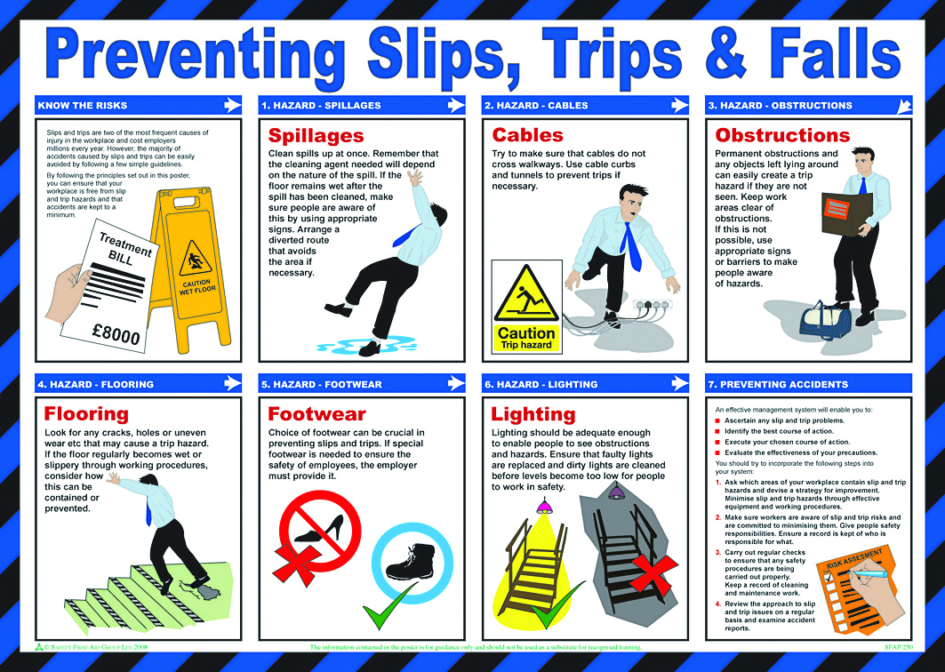

Slide 11
OFFICE ENVIRONMENT
Office layout should incorporate workflow, safety, health and convenience.
Offices should provide adequate room for employees to enter and exit, especially in the event of an emergency.
Sometimes illumination in your office can be inadequate or interfere with your vision, ensure this doesn’t happen by keeping illumination levels consistent and avoiding sources of glare.
Never run in office areas and keep to the right while walking in passageways.
Employees should remain clear of doors and stand away from the door swinging path.

Slide 12
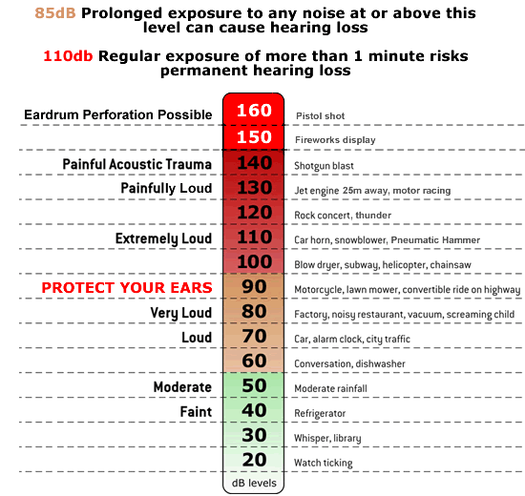
NOISE
Noise in office settings is generally not hazardous but can be distracting and may interfere with your work. Here are some things to remember to help reduce noise:
Keep noisy items away from areas that require a quiet atmosphere, such as answering the phone.
Schedule noisy activities at times that will have less of an effect on other employees.
Ensure all mechanical equipment is maintained to prevent any loose parts from making noise or squeaking.
Refer to the chart to see if you may have any noise in your office that could be hazardous.

Slide 13
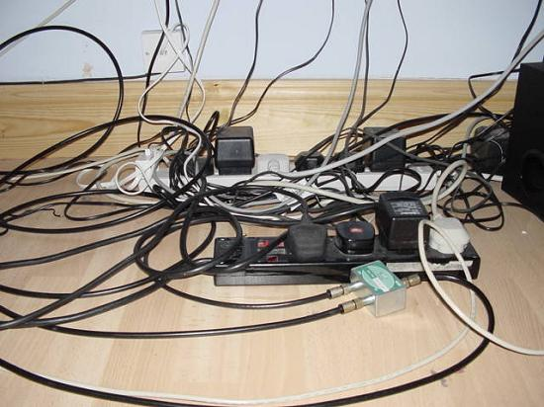
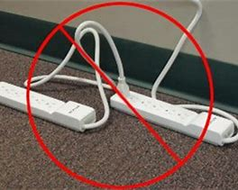
ELECTRICAL HAZARDS
Do not overload sockets. Ask for additional outlets to be installed.
If any cables become warm to the touch, this could indicate a fire hazard. Unplug and report the issue.
Replace damaged or frayed electrical cords.
Cables should never be placed under carpet or rugs or in walkways.
Never use an extension cord in an area permanently.
Extension cords are designed for temporary use.
Never “daisy chain” extension cords.

Slide 14
INDOOR AIR QUALITY
Indoor air quality is the study of pollutant levels within the office environment. Often, health symptoms associated with indoor air quality are vague and similar to symptoms that can occur from conditions at home. Usually, contaminant levels are far too low to require occupational evaluation. However, if you are concerned about the contaminant levels in your office, take a look at some of the factors that may require further investigation:
Office plans changing to accommodate more employees.
Building renovations, such as installation of new carpet and painting.
Blocked air vents.
Water leaks/spills that could lead to mold growth.
Improper waste disposal.

Slide 15
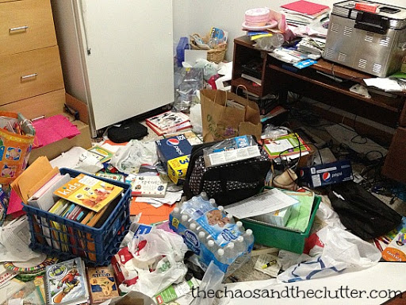
HOUSEKEEPING
Good housekeeping is an important element in preventing accidents.
Poor housekeeping may lead to fires, injuries, and poor health.
All aisles within the office should be clear and free of obstructions.
Damaged chairs, files, bookcases, and desks must be replaced or repaired.
Materials stored within supply rooms must be neatly stacked and readily reached by adequate aisles. Never stack materials within 18 inches of fire sprinkler heads.
Never stack materials in aisles or passageways in a manner that could cause persons to trip or hinder emergency evacuation.

Slide 16
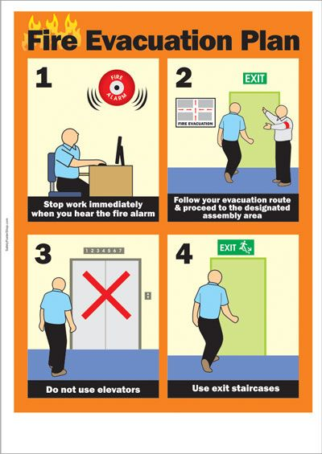
EMERGENCY PROCEDURES
In the event of an emergency, always follow your office procedures for evacuation.
Assist anybody who can’t help themselves.
Do not run to exits, walk and stay alert.
In the event of a fire, only attempt to use a fire extinguisher if you feel confident and the area of the fire is no larger than the size of a small trash can.

Slide 17
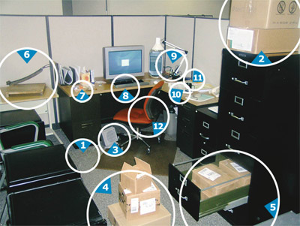
IDENTIFY THE HAZARDS
1. ____________
2. ____________
3. ____________
4. ____________
5. ____________
6. ____________
7. ____________
8. ____________
9. ____________
10. ____________
11. ____________
12. ____________

Slide 18
IDENTIFY THE HAZARDS
Tripping hazard
Fall hazard
Clutter
Clutter
Open drawer
Exposed blade
Clutter
Eye strain
Electrical hazard
Clutter
Spill hazard
Non-ergonomic chair

Slide 19

PROGRAMS AND SERVICES
ENVIRONMENTAL HEALTH AND SAFETY
Fire Protection Engineering
Life Safety and Emergency Preparedness
Environmental Compliance
Laboratory Safety
Occupational Safety
Occupational Health and Medical Surveillance
Materials Management
Industrial Hygiene
Chemical Hygiene
Safety Training

Slide 20

ENVIRONMENTAL HEALTH & SAFETY
OKLAHOMA STATE UNIVERSITY
O | 405.744.7241
E | ehs@okstate.edu
UHS Suite 002
ehs.okstate.edu

Slide 21

QUESTIONS?

