Slide 1
Sun Safety
Greg Hogan
Oklahoma State University Environmental Health and Safety (405) 744-7241
Current as of June 2024

Slide 2
Objective
The Skin Cancer Problem
The Sun and Your Skin
Assessing Your Personal Risk
Practicing Sun Safety
Spotting skin cancer early
Sun Safety and Employees

Slide 3
Skin Cancer Problem

Slide 4
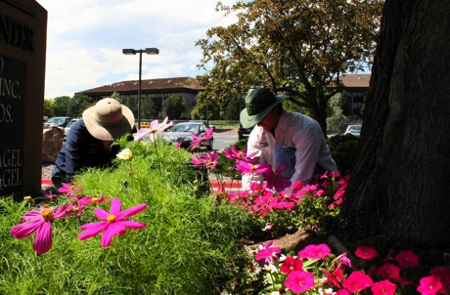
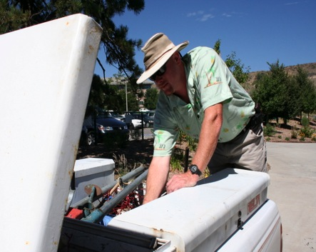
Skin Cancer Prevention is Now!

Slide 5
Skin Cancer Facts
Skin cancer is the most common cancer in the U.S.
There are > 5 million new cases of skin cancer each year.
One in five Americans will get skin cancer.
Men get skin cancer more often than women.
Source: American Cancer Society

Slide 6
Melanoma Facts
Over 100,000 cases of melanoma will be diagnosed this year.
There will be about 7,000 melanoma deaths.
Melanoma increased 45% in the U.S. from 1992 to 2004.
THE MOST COMMON cancer for young adults (25-29).
Sources: American Cancer Society & National Cancer Institute

Slide 7
UV and Skin Cancer Facts
Ultraviolet radiation is a carcinogen.
UV causes 90% of all skin cancer.
UV can be natural -- from the sun.
UV can be artificial -- from tanning lamps.

Slide 8
UV is a Carcinogen
Asbestos
Vinyl chloride
Chromium compounds
Radon
Ultraviolet Radiation
Benzene
Arsenic
National Toxicology Program
Department of Health & Human Services

Slide 9
The Sun: Benefits and Harms
BENEFITS:
Heat
Light
Photosynthesis
Outdoor environment for physical activity
Production of vitamin D
Happy & positive
feelings; good mood
HARMS:
Suntan
Sunburn
Premature aging
Freckles
Liver spots
Wrinkles
Loss of elasticity
Cataracts
Immune system suppressant
Skin cancer

Slide 10
What Can You Do?
Understand the connection between UV rays and skin cancer
Know your personal risk
Practice sun safety
Be a role model for others

Slide 11
The Sun and Your Skin

Slide 12
UV and The Electromagnetic Spectrum

Slide 13
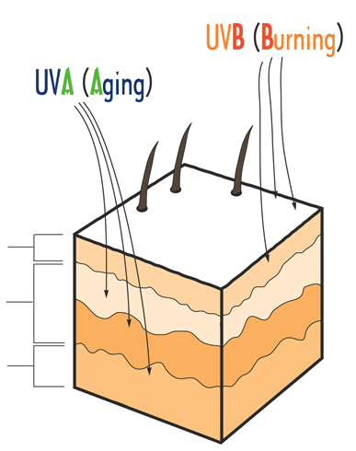
UVA and UVB Radiation
Solar UV radiation is 95% UVA & 5% UVB.
UVA causes tanning, aging & skin cancer.
UVB causes burning & skin cancer.
Tanning beds emit 12 times more UVA than the sun.
Skin cancers occur in the epidermis.
EPIDERMIS
DERMIS
SUBCUTIS

Slide 14
How Skin Cancer Starts
Cancers develop because of abnormal cell growth.
Skin cancer develops because of abnormal growth of our basal, squamous or melanocyte cells.

Slide 15
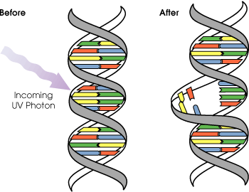
How Skin Cancer Starts
UVA and UVB rays hit the epidermis.
DNA in skin cells begins to break down.

Slide 16
How Skin Cancer Starts
The breakdown causes the cells to grow out of control and form a mass of cancer cells.
The immune system tries to repair the damage.
More sun exposure hampers repair.
Damaged cells can mutate into skin cancer within 5 years.

Slide 18
Types of Skin Cancer
Non-melanoma Skin Cancer
Basal Cell Carcinoma
Squamous Cell Carcinoma
Malignant Melanoma

Slide 19
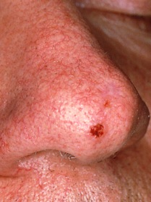
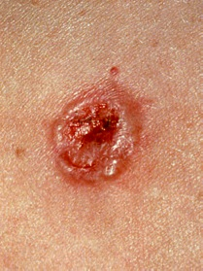
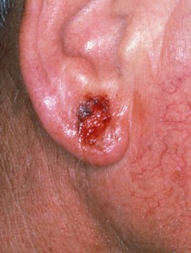
Basal Cell Carcinoma

Slide 20
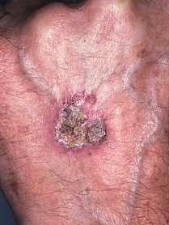
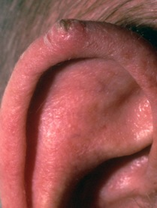
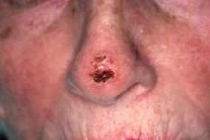
Squamous Cell Carcinoma

Slide 21
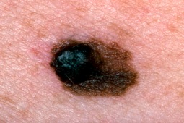
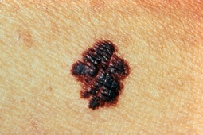
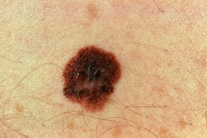
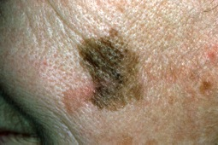
Malignant Melanoma
Larger Odd Shape
Varied Color

Slide 22
Lessons Learned: Ban the Burn!
Studies have shown that FIVE severe sunburns early in life may DOUBLE the risk for developing melanoma later in life.
Avoid getting burned!

Slide 23
Lessons Learned: There’s No Such Thing as a Healthy Tan
A suntan is your skin’s way of trying to protect itself from damaging UV rays.
Suntans give very little protection - about an SPF 3.
Skin gets damaged while getting a tan, including aging from UVA rays and cumulative lifetime exposure.

Slide 24
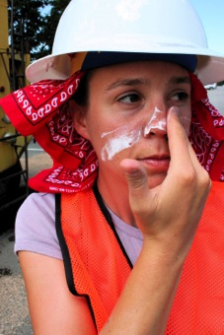
Most Skin Cancer is Preventable
Know your risk
Practice sun safety
Examine your skin

Slide 25
Assess Your Risk for Skin Cancer

Slide 26
Understanding Your Risk
Your risk of getting harmed from over-exposure to UV is determined by:
Who You Are
Your Personal Risk
Where You Live
What You Do

Slide 27
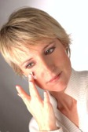
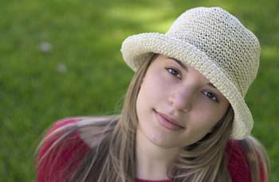
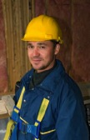
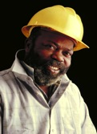
Who You Are: The Six Skin Types
Always burns, never tans, sensitive to sun exposure
Burns easily, tans minimally
Burns moderately, tans gradually to light brown
Burns minimally, always tans well to moderately brown
Rarely burns, tans profusely to dark
Never burns, deeply pigmented, least sensitive

Slide 28
Highest Risk Factors
Blond or red hair
Blue, green or gray eyes
Fair skin
Skin that freckles easily
Skin that burns easily and doesn‘t tan
Many moles; large moles
Family members with melanoma
Male

Slide 30
Where You Live:
Sunny days.
High elevation: UV intensity increases 5% every 1000 feet above sea level.
An outdoor-oriented lifestyle.

Slide 31
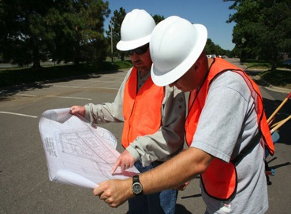
What you do: Outdoor Workers
Get up to 8 times more UV than indoor workers
Have a 60% greater risk of developing skin cancer
Are at higher risk for non-melanoma skin cancer
Indoor workers are at higher risk for melanoma

Slide 32
Reflective Work Surfaces
Flowers & lawn grass: 1-2%
Clay soil: 4-6%
Aged asphalt roadway: 5-9%
Light concrete: 10-12%
Weathered aluminum: 13%
Sand: 15-18%
Water: 20-25%
White metal oxide house paint: 22%
Fresh snow: 88%

Slide 33
What else do you do ???
Do you sunbathe to get a tan?
Do you use tanning lamps?
Do use sun protection?

Slide 34
Think Sun Safety!

Slide 35
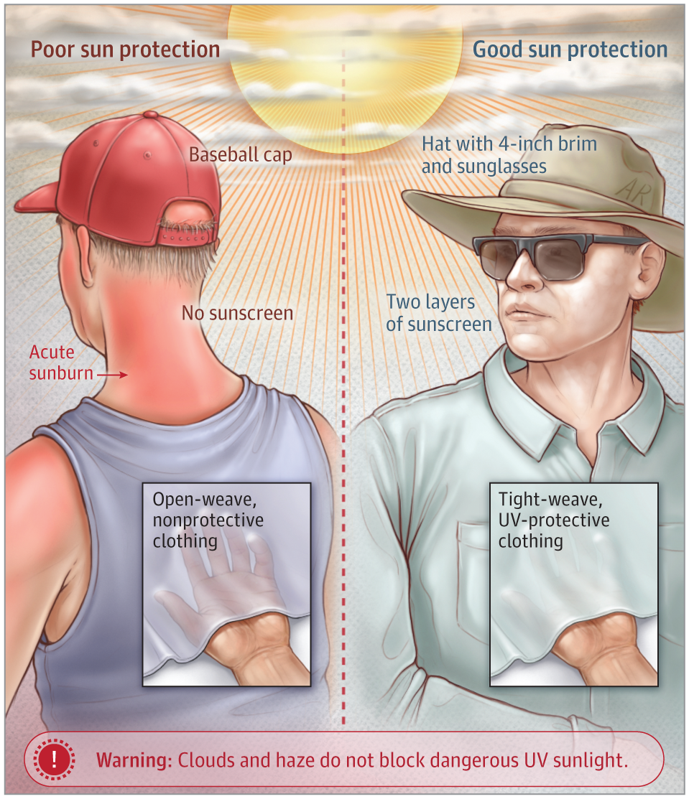
Checklist for Sun Safety
Monitor UV
Use Shade
Cover Up
Clothes
Sunglasses
Hats
Apply Sunscreen

Slide 36
Monitor UV
Check the UV Index for high UV days.
Watch the clock for peak UV hours of 10:00 am to 4:00 pm.
Check the weather; Clouds block only 20% to 40% of UV.
Arrange work around peak sun hours if possible.

Slide 37
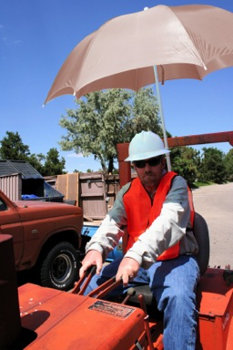
Use Shade
Bring portable shade cover to your job site.
Attach a shade device to your road equipment.
Seek shade structures or umbrella tables for breaks.
Go indoors for lunch or meetings.
Work inside during peak sun hours.
If you work in a car or truck, the glass blocks UVB, but not all UVA.

Slide 38
Skin Cancer and Driving
More UV-related melanoma skin cancer occurs on the left side of the body in the US
The left arm is more affected than the right arm
An open window increases UV dose 5X more than a closed window

Slide 39
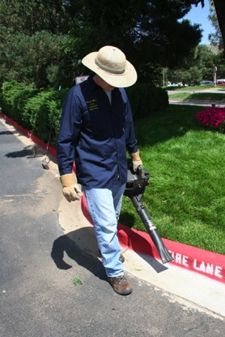
Cover Up
Long Sleeves
Long Pants
Sunglasses
Hats
Gloves

Slide 40
Photo-damaged Skin
Changes in the skin from prolonged exposure to solar irradiation.

Slide 41
Sun Protective Clothing
Clothing can block 100% of UVA and UVB.
Wear clothing that covers a large amount of your skin.
Wear long-sleeved shirts and long pants.
Choose fabrics with a tight weave that allows little or no light to pass through.
A thin white t-shirt has an SPF of about 4.
Wear darker colors because they absorb more UV.

Slide 42
Hats
Less Sun Safe More Sun Safe
Choose wide-brimmed hats.
Any hat is better than NO hat!

Slide 43
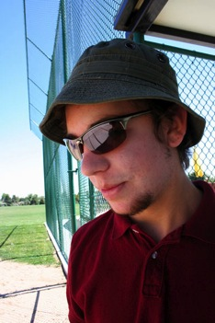
Sunglasses
UV can cause cataracts, macular degeneration, blindness and melanoma of the eye.
Wear large sunglasses that block 99%-100% of UV rays.
Look for lenses labeled UV 400 or ANSI Z80.3.
Lenses don’t have to be dark or expensive.

Slide 44
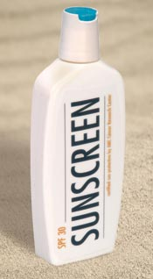
Apply Sunscreen
Lotion
Gel
Stick
Towelette
Make up
Lip balm

Slide 45
New FDA Proposal (Introduced February 2019)
Broad Spectrum Protection SPF of 15 or higher – certified to protect against UVA.
Limit exposure, especially between 10 a.m. and 2 p.m.
Can longer use: Sunblock, Waterproof, All Day Protection, Sweat Proof.
Apply 2 hours before going outside.
Reapply every 2 hours.
Water Resistant – 40 or 80 minutes.
Check for expiration date if there is not one then discard after 3 years.

Slide 46
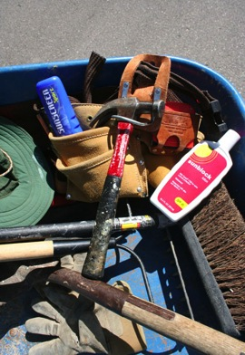
Sunscreen Basics
Choose SPF 30 or more for working outdoors.
Use a broad-spectrum sunscreen for UVA and UVB.
Make sunscreen a daily habit.
And don’t forget lip balm with SPF 15 or more.
Sunscreen expiration date is 3 years from date of manufacture.

Slide 47
What is SPF?
SPF = Sun Protection Factor
SPF tells you how much UV will be absorbed or reflected.
SPF also tells you how long a sunscreen will protect your skin from sunburn.
SPF is a measure of UVB protection, not a measure of UVA protection.

Slide 48
Strength of Protection
SPF 15 screens 93% of UVB
SPF 30 screens 97% of UVB
SPF 50 screens 98% of UVB
SPF 70 screens 98.5% of UVB
SPF 100 screens 99% of UVB
No sunscreen blocks 100% of UV.

Slide 49
Length of Protection
Your Time To Burn Without Protection
x SPF of your sunscreen
= ____ MINUTES OF PROTECTION
Examples (fair skin):
12 minutes x SPF 15 = 180 minutes (3 hours) until sunburn
12 minutes x SPF 30 = 360 minutes (6 hours) until sunburn
12 minutes x SPF 45 = 540 minutes (9 hours) until sunburn

Slide 50
Two Types of Sunscreen
Chemical UV Absorbers
Chemicals that work like a sponge on your skin to absorb UV for a set amount of time
Need time to bond with skin; do not work right away
Harder to rub off
Physical Reflectors
Tiny metals that work like aluminum foil to reflects UV away from your skin
Don’t need time to bond with skin; work right away
Easier to rub off
Both work well; use what you like.

Slide 51
The Rule of Two Fingers: How Much Sunscreen to Apply

Slide 52
The Rule of Two Fingers: Where to Apply Sunscreen

Slide 53
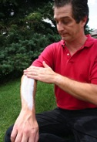
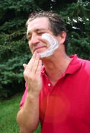
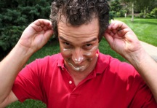
How to Apply Sunscreen
Apply it about 15-30 minutes before going out in the sun.
Apply it on all exposed skin, but not open wounds.
Don’t forget places like ears, neck and hands.
Don’t rub it in too hard – it reduces effectiveness by at least 25%.

Slide 54
When to Reapply
Reapply after 20 minutes to cover missed spots.
Reapply every two hours to keep it powerful.
Reapply more often after sweating.

Slide 55
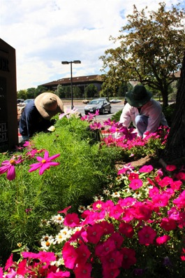
Sunscreen and DEET Mosquito Repellant
Use separate products
Apply sunscreen first; then repellant
Reapply sunscreen often; don’t reapply repellant (25% DEET should last 5 hours)

Slide 56
Practice Early Detection

Slide 57
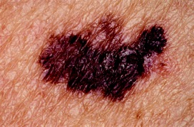
Detect Skin Cancer Early
At least 95% of skin cancer can be cured if detected early.
Look for changes in spots or moles.
Look for sores that don’t heal.
Report unusual findings to your doctor.

Slide 58
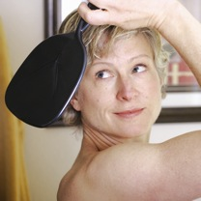
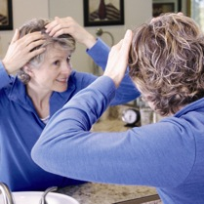
Check Your Self !

Slide 59
Know Your ABCDE’s for Moles
A= Asymmetry: One half of the mole or birthmark doesn't match the other.
B= Border: The edges are ragged, irregular, or poorly defined.

Slide 60
ABCDE Rule Continued
C=Color: Color varies from one area to another and may have differing shades of brown, black, white, red or blue.
D=Diameter: Area is larger than 6 mm (about the size of a pencil eraser) and is growing larger.
E=Evolving: Show any changes in size, color, shape or texture of a mole (or any skin changes) to your doctor.
-- American Academy of Dermatology

Slide 61
Take Aways
Some UV exposure is healthy, but avoid over-exposure, sunburns and suntans.
Limit your unprotected time in the sun, especially during peak UV hours at midday in the summer.
Find shade or bring it with you.
Use sunscreen with SPF 30 or higher every day.
Wear cover-up clothing, hats and sunglasses.
Don’t use tanning beds or lamps.
Check your skin for changes every year

Slide 62
Sun Safety Apps
There are some great products available to provide information on expected UV from the sun.
EPA’s SunWise UV Index App
https://itunes.apple.com/us/app/epas-sunwise-uv-index/id466052686?mt=8
Robocat Ultraviolet UV Index
https://itunes.apple.com/us/app/ultraviolet-uv-index/id445874481?mt=8&ign-mpt=uo%3D4

Slide 63
Environmental Health and Safety
Programs and Services
Fire Protection Engineering
Life Safety & Emergency Preparedness
Environmental Compliance
Laboratory Safety
Occupational Safety
Occupational Health and Medical Surveillance
Materials Management
Industrial Hygiene
Chemical Hygiene
Safety Training
Location: University Health Services Bldg, Room 002 (basement)
Phone number: 744-7241 Email: EHS@okstate.edu
Website: http://ehs.okstate.edu/

Slide 64
Questions ?

